Slide 1
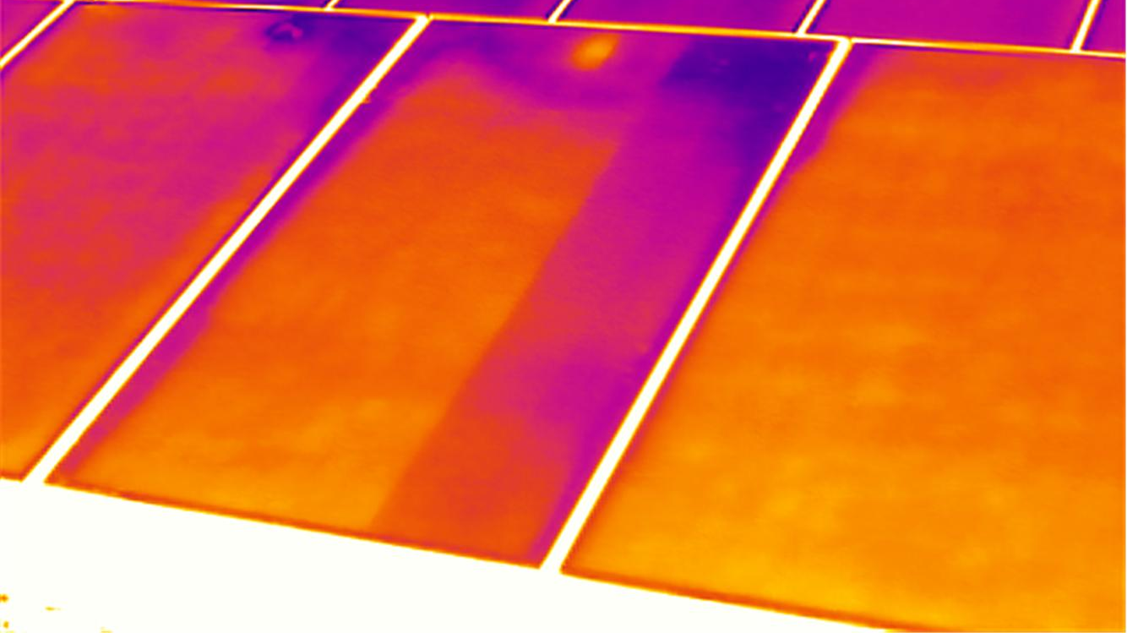




Critical Design Review
December 4, 2014
Cameron Comeau, Daniel Flora, Smith Johnston, Alexander Potter, Maria Rocco, Evan Schomer, Dylan Stewart, Sarah Wilson, Ashley Zerr

Slide 2
Presentation Structure
Maria
Sarah
Sarah
Dylan
Evan
Ashley
Ashley
Overview
Sensor Selection
Mechanical
Thermal
Electrical & Software
Integration & Test
Management
Purpose, Overview of Design Solution,
CPE’s
Major Driving Requirements
Design Solution
V&V
Risks, Plans, Overview of Design Solution
Notes:
Maria

Slide 3
PDR Comments Addressed
Requirement for multiple sensors
Sensor Interface
Thermistor Attachment
Wire Management
Thermal Gradient
Sensor Selection
Mechanical
Mechanical
Mechanical
Thermal
20
25
29
30
44
Notes:
Maria

Slide 4
Overview & Design Solution
Overview
Mechanical
Management
Sensor Selection
Thermal
Integration & Test
Electrical & Software

Slide 5
Project Purpose
STATIS =TEST BED
Characterize
5 Different COTS Non-Contact IR Sensors over:
3 Distances between ¼ - 3”
11 Temperatures between 250-350 K
Vacuum Environment
5 Target Surfaces
Overview
Mechanical
Management
Sensor Selection
Thermal
Integration & Test
Electrical & Software
Notes:
Maria

Slide 6
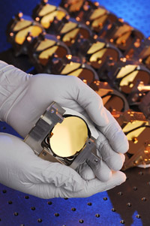
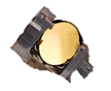
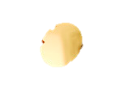
Motivation
Fast Steering Mirrors (Ball Aerospace)
Inability to sense temperatures with
current temperature sensors due to:
  Complex wiring systems across moving parts
  Marring of the surface - reducing the effectiveness of the surface
Overview
Mechanical
Management
Sensor Selection
Thermal
Testing & Integration
Electrical & Software
Notes:
Complex wiring … currently used for recording temperature data aboard spacecraft
Maria
Visual – pic of mirror, draw line to represent wire – another visual with rotation and abrasion

Slide 7
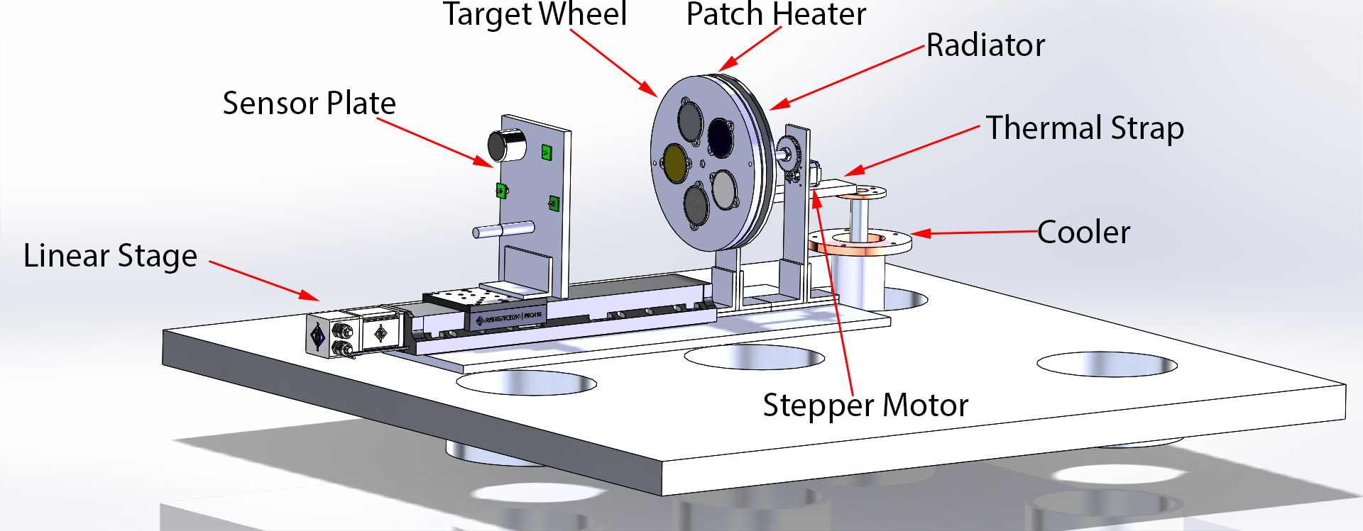

Design Solution Assembly
Overview
Mechanical
Management
Sensor Selection
Thermal
Testing & Integration
Electrical & Software

Slide 8
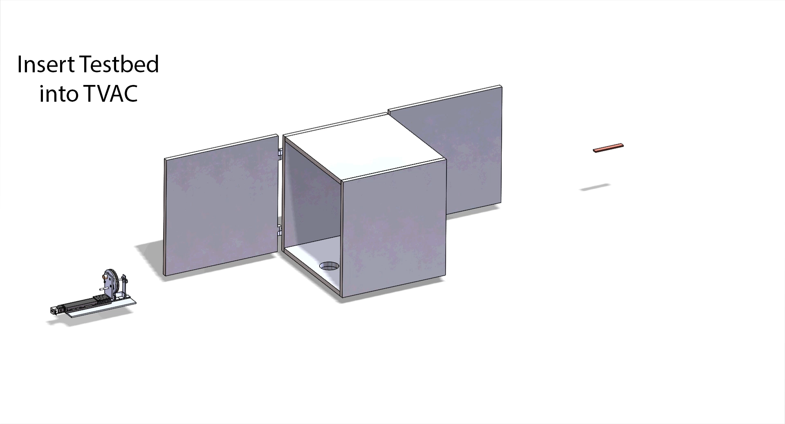
Concept of Operations
Overview
Mechanical
Management
Sensor Selection
Thermal
Testing & Integration
Electrical & Software

Slide 9
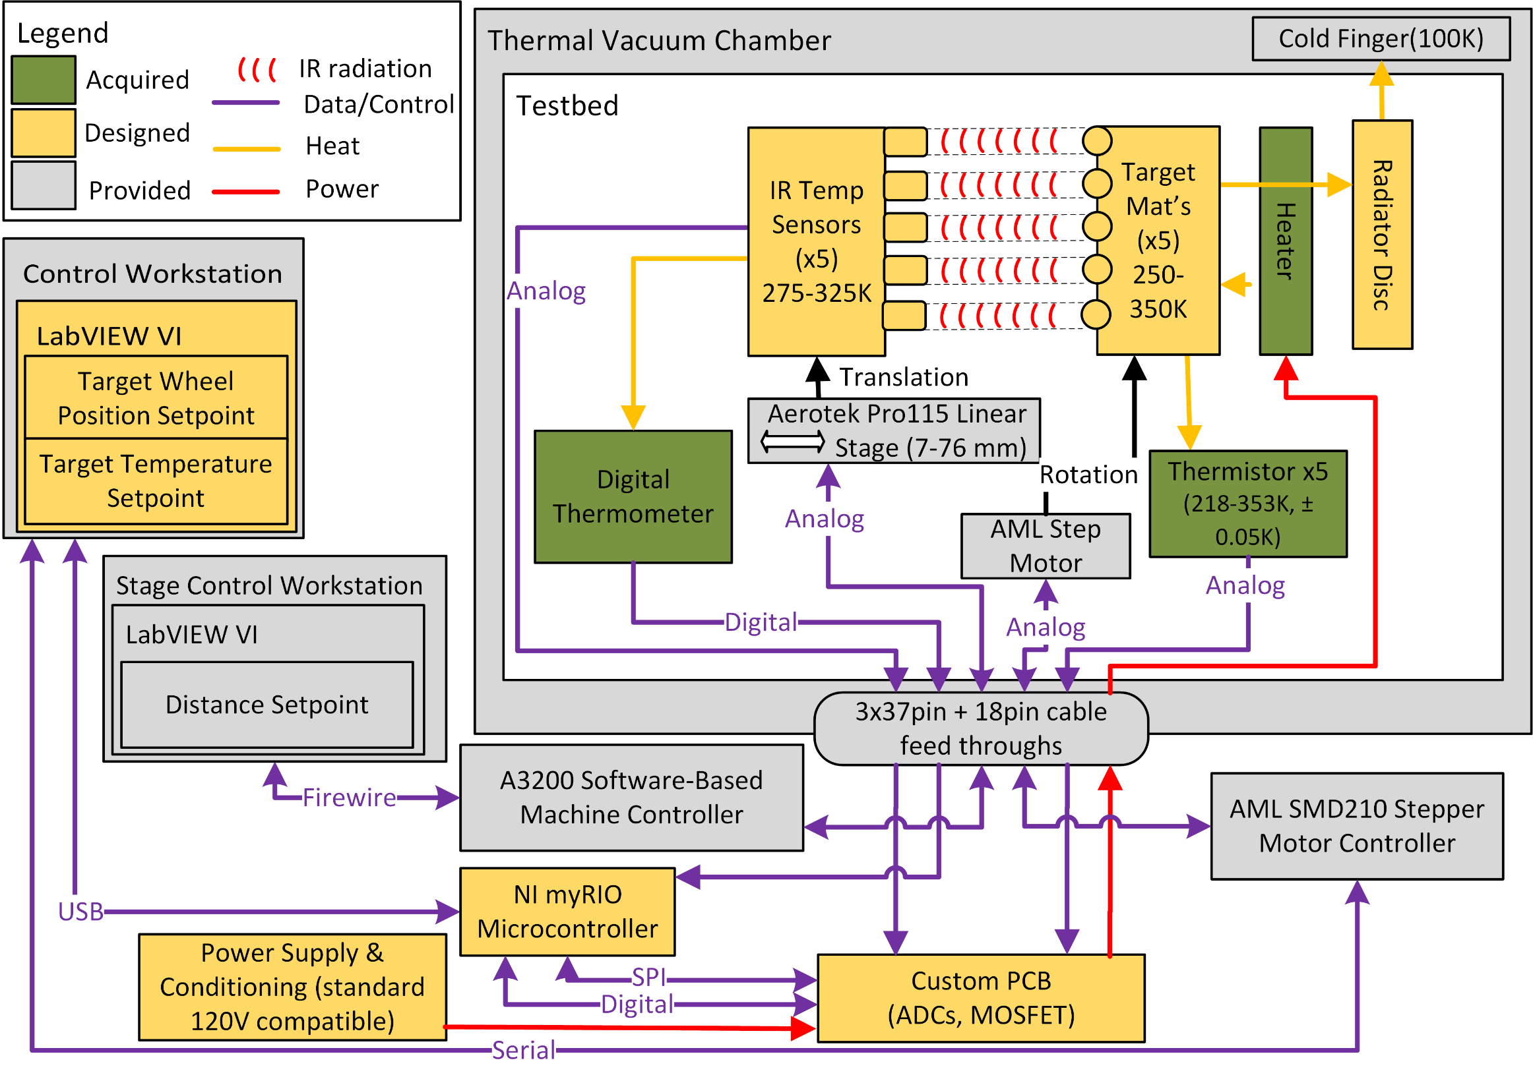
Functional Block Diagram
CDR
Notes:
Dylan

Slide 10
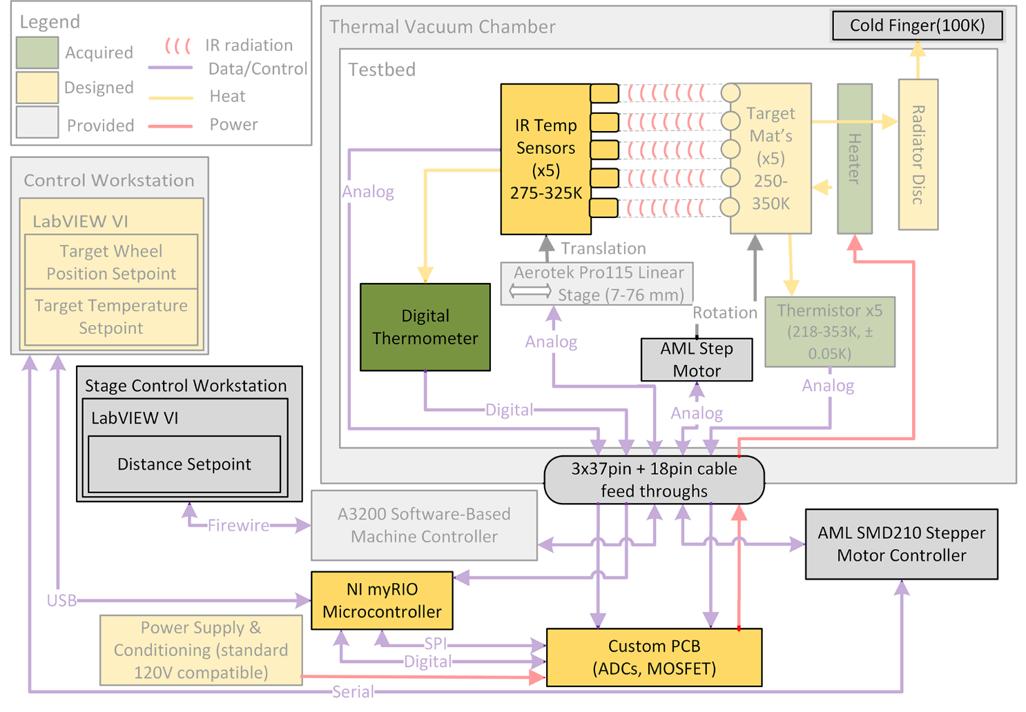
Functional Block Diagram
CDR Updates
Notes:
Dylan

Slide 11
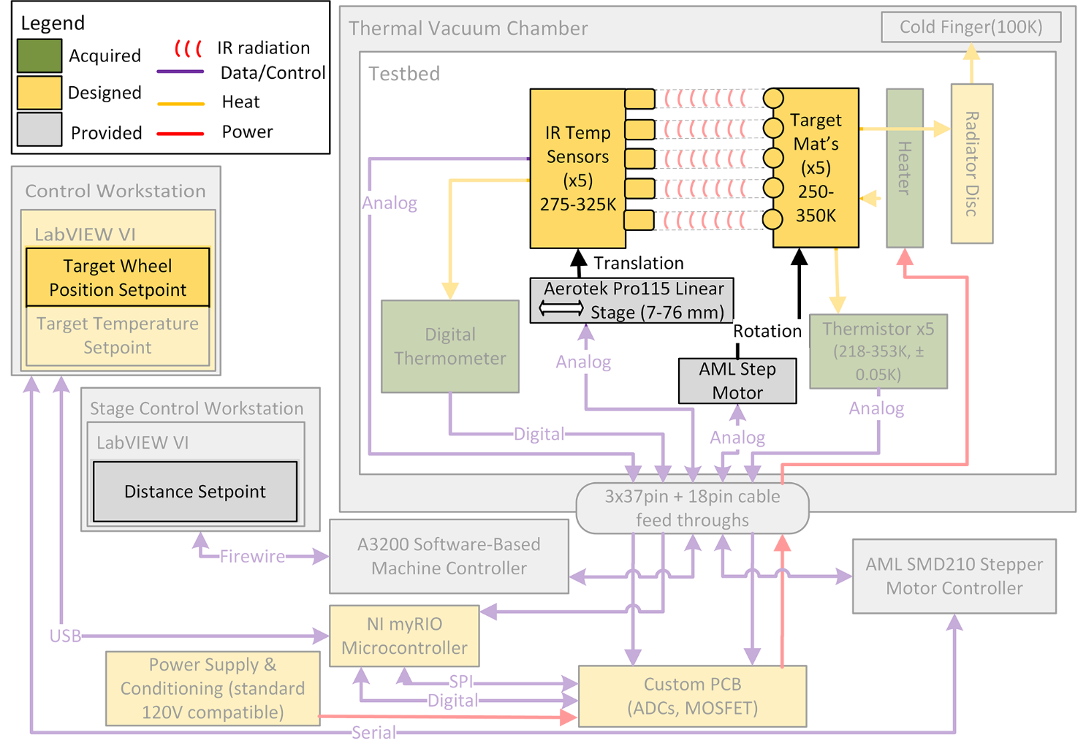
Functional Block Diagram - Mechanical
Notes:
Dylan

Slide 12
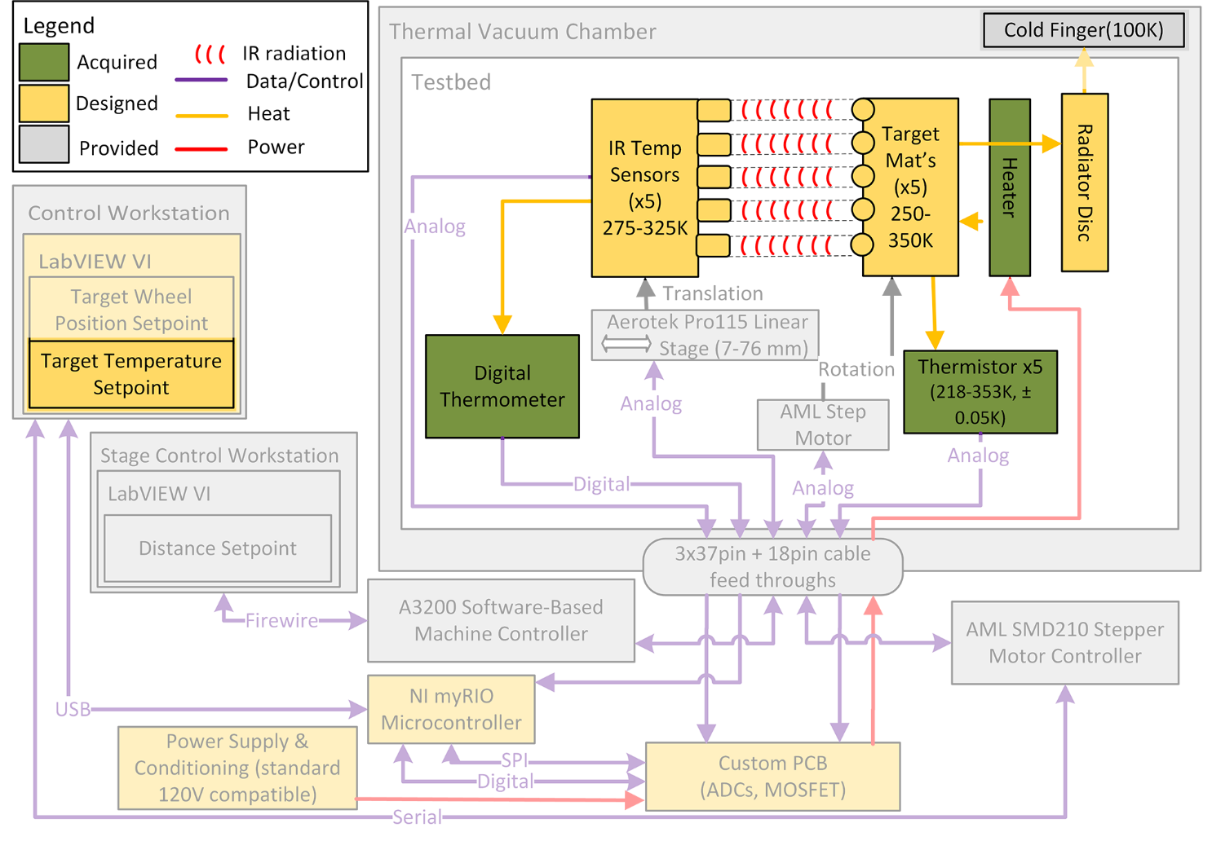
Functional Block Diagram - Thermal
Notes:
Dylan

Slide 13
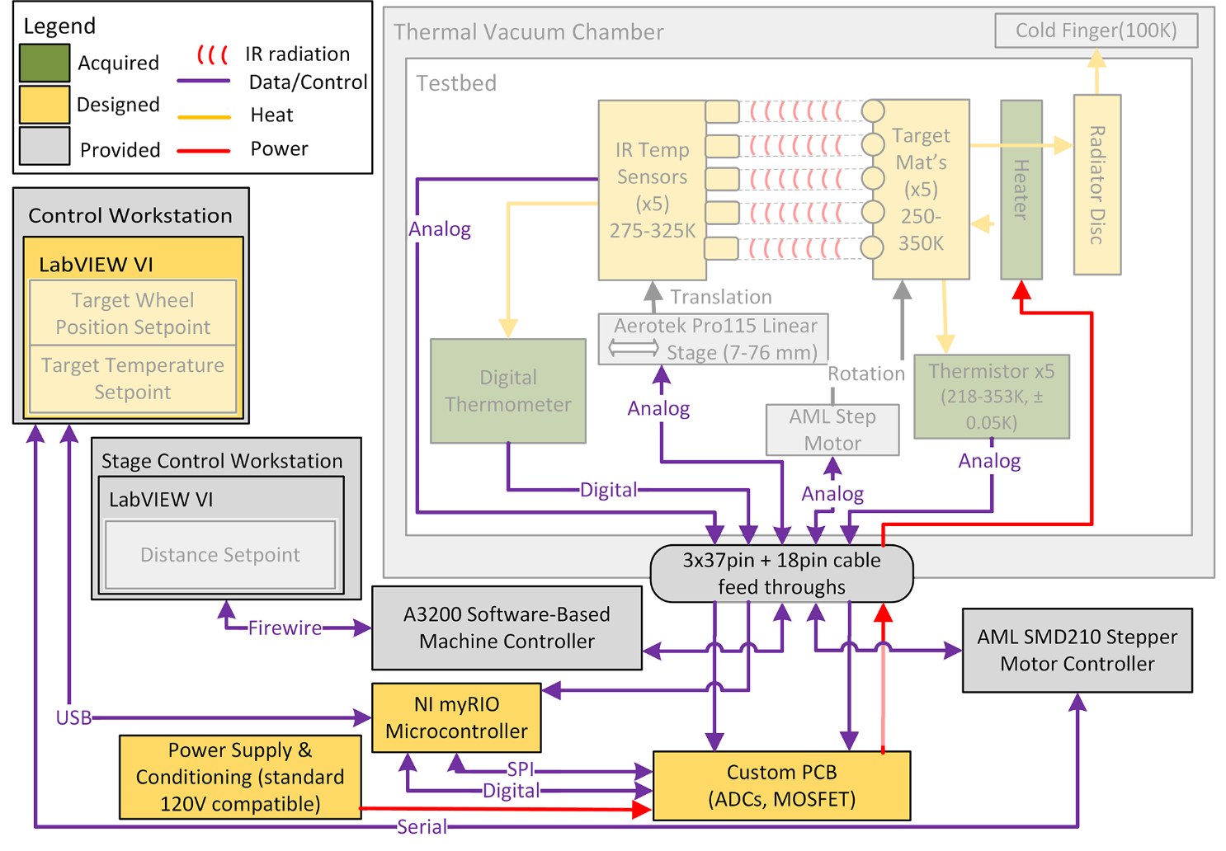
Functional Block Diagram – Electrical
& Software
Notes:
Dylan

Slide 14
Functional Requirements Overview
FR 1 = Vary parameters
(distance, temp, target)
FR 2 = Collect measurement data
(distance, temp, target, IR sensor output)
FR 3 = Integrate with thermal vacuum chamber
Overview
Mechanical
Management
Sensor Selection
Thermal
Integration & Test
Electrical & Software
Notes:
Say TARGET temps

Slide 15
Functional Requirements
FR 1: STATIS shall vary parameters relevant to characterizing the performance of COTS non-contact infrared temperature sensors.
DR 1.1 Vary Distance (Min =1/4 inch; Max =3 inches; 3 incremental steps)
DR 1.2 Vary Temperature (Min=250K; Max=350K; 10K steps)
DR 1.3 Vary Target Surfaces (5 surfaces; unique ID; FOV consideration)
Overview
Mechanical
Management
Sensor Selection
Thermal
Integration & Test
Electrical & Software
Notes:
Maria

Slide 16
Functional Requirements
FR 2: STATIS shall collect measurement data required to characterize the performance of the COTS IR sensors.
DR 2.1 Target temperatures collected via contact temp sensors (accuracy of ≤1K; STD ≤ 0.1K)
DR 2.2 Sensor under test and Target under test shall be known (unique ID’s)
DR 2.3 Creation of test file at any time (UTF-8 csv file)
DR 2.4 Time stamped (resolution of 100ms ±50ms)
Overview
Mechanical
Management
Sensor Selection
Thermal
Integration & Test
Electrical & Software
Notes:
MR

Slide 17
Functional Requirements
FR 3: STATIS shall be designed for use within Ball Aerospace’s thermal vacuum chamber.
DR 3.1 Electrical interface (3x37 pin connector and 1x @ ≤7.5 MHz; analog and digital signals; resistance known to within 3Ω)
DR 3.2 IR sensors temperature (between 275-325K)
DR 3.4 Meet outgassing and pressure standards
DR 3.5 Fit in 5 day test period
DR 3.6 Size constraints (4x4x4 feet)
Overview
Mechanical
Management
Sensor Selection
Thermal
Integration & Test
Electrical & Software
Notes:
MR

Slide 18
Critical Project Elements
CPE.1: Sensor Selection
→ Budget, Mechanical Integration and Electrical Interface
CPE.2: Mechanical System
→ Rotation, Translation, Interface with Provided Hardware
CPE.3: Thermal Modeling and Control
→ Heat Dissipation and Feasibility of Control Algorithms
CPE.4: Electrical & Software Systems
→ Contact Temperature Sensor Precision and Accuracy
CPE.5: TVAC Integration
→ Materials Acquisition and Compatibility
Overview
Mechanical
Management
Sensor Selection
Thermal
Integration & Test
Electrical & Software
Notes:
5% of grade
Maria
Cp 3 Model and control

Slide 19
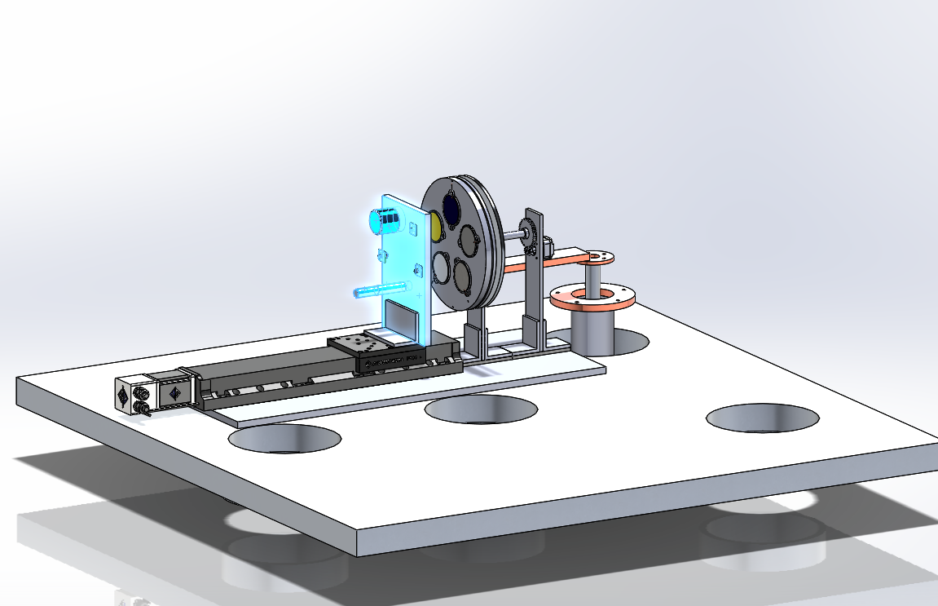
Sensor Selection
IR Sensor Plate
Goals:
Find viable COTS non-contact IR sensors.
Major Modifications from PDR:
5 different IR sensors
Overview
Mechanical
Management
Sensor Selection
Thermal
Integration & Test
Electrical & Software
Notes:
5% of grade
Maria
Cp 3 Model and control

Slide 20
Sensor Selection Driving Requirement
DR 1.3.2 Four or more non-contact IR sensors shall be integrated into STATIS
  Motivation:
  The intent is to use multiple sensors in order to get a sample of the available technology and characterize the IR sensors.
  Allow testing of alternative sensors through a modular IR sensor plate design.
Overview
Mechanical
Management
Sensor Selection
Thermal
Integration & Test
Electrical & Software
Notes:
Smith - ____ Driving Requirement

Slide 21
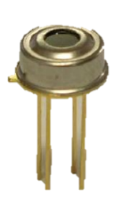
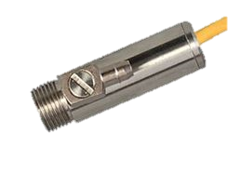
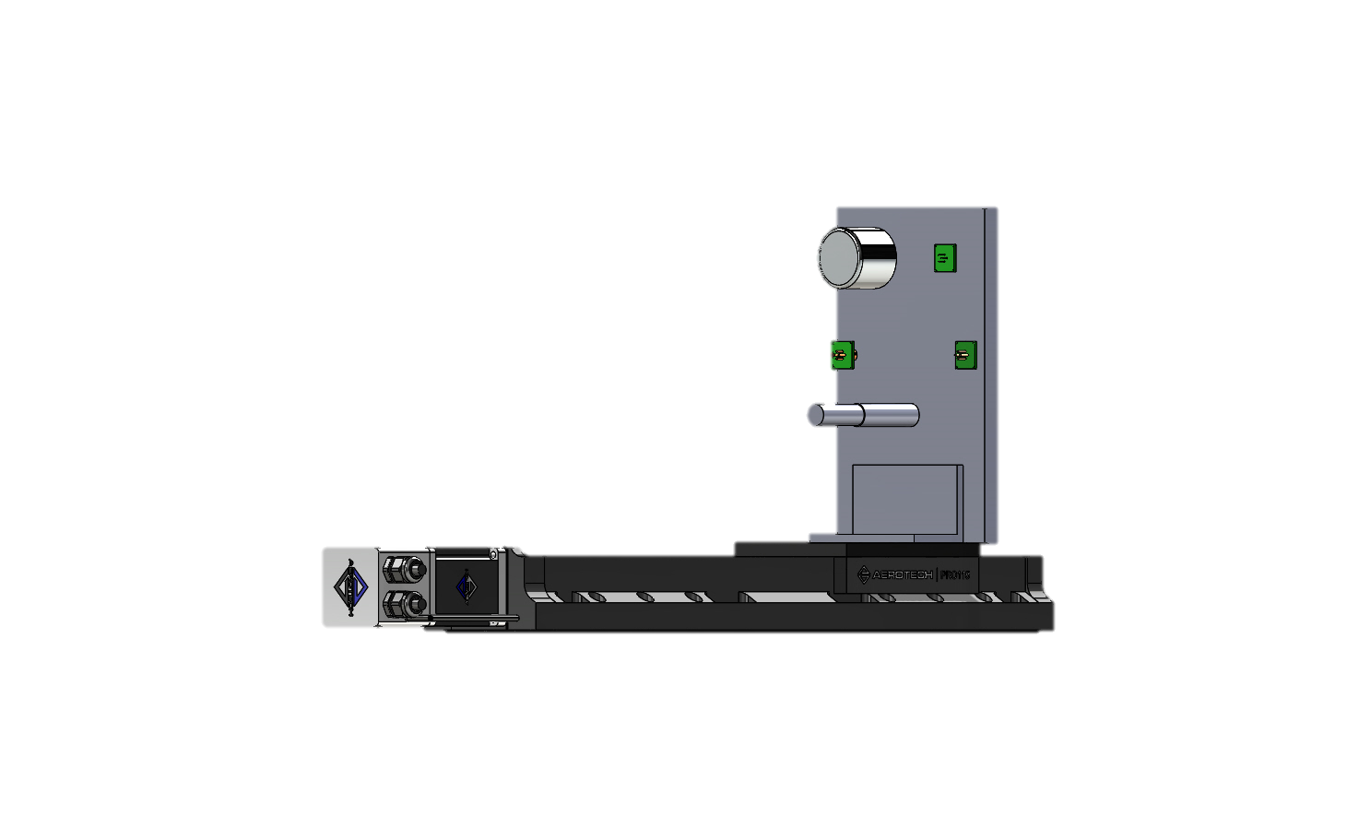


IR Sensor Selection
All sensors shall undergo the bake out process at Ball Aerospace.
Sensor 5
Sensor 1
Sensor 2
Sensor 4
Sensor 3
Overview
Mechanical
Management
Sensor Selection
Thermal
Integration & Test
Electrical & Software
Notes:
Smith

Slide 22
FOV Driving Requirement
DR 1.1.2 The maximum distance between the target surfaces and non-contact IR sensors shall be 3 inches.
  Motivation: The intent is to replicate the expected maximum distance between the non-contact IR sensors and target surfaces in the intended application on spacecraft.
Overview
Mechanical
Management
Sensor Selection
Thermal
Testing & Integration
Electrical & Software
Notes:
Smith
___ Driving Requirement
CHANGE THE REQUIREMENT 1.1.3?

Slide 23

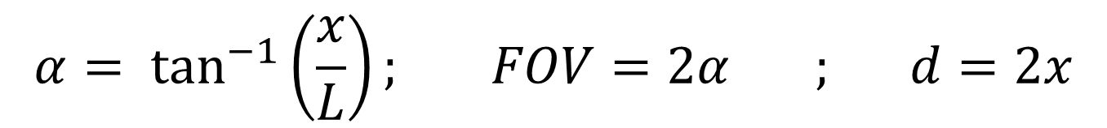
FOV Calculation
 | Sensor | FOV
1 | OS36 | 17°
2 | MLXA | 35°
3 | TPT | 5.5°
4 | MLXBAD | 40°
5 | MLXB | 10°
x
Sensor
$$α$$
d
L = 3”
At distance, L, of 3 inches
FOV = 41°
All sensors have FOV <41°
$$α= \tan^{−1}\left(\frac{x}{L}\right); FOV=2α ; d=2x$$
Overview
Mechanical
Management
Sensor Selection
Thermal
Integration & Test
Electrical & Software
Notes:
Smith

Slide 24
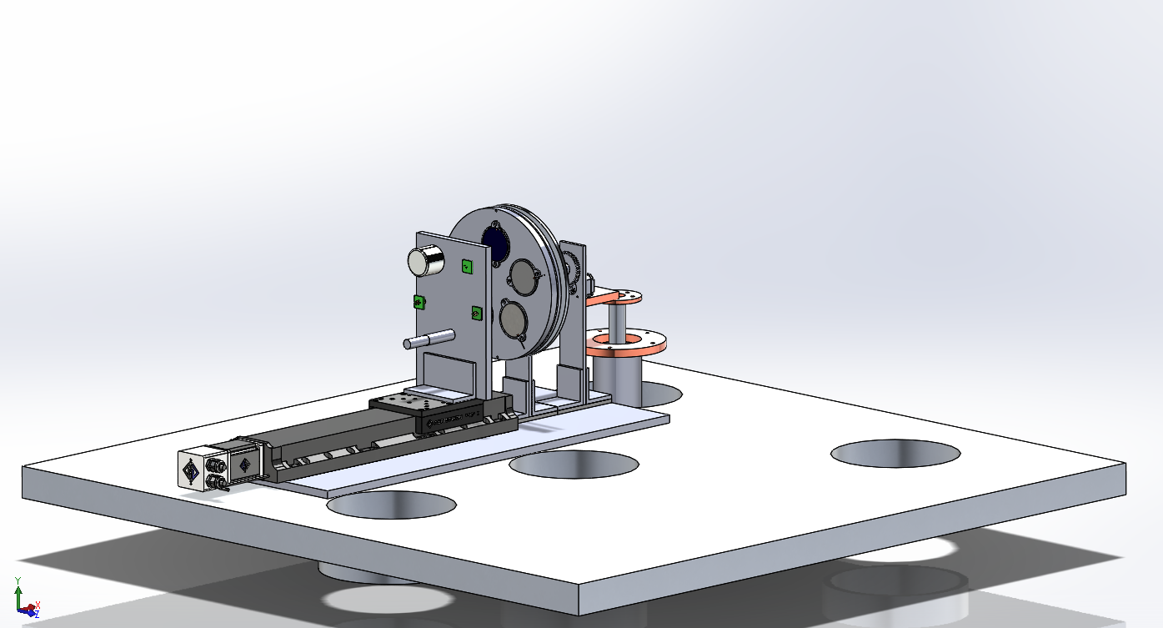
Mechanical System
Goals
House Sensors
Change Distance
Change Target Surface
Major Modifications from PDR:
Step Motor provided by Ball
TVAC Compatibility
5 different IR sensors
Overview
Mechanical
Management
Sensor Selection
Thermal
Integration & Test
Electrical & Software
Notes:
Sasha

Slide 25
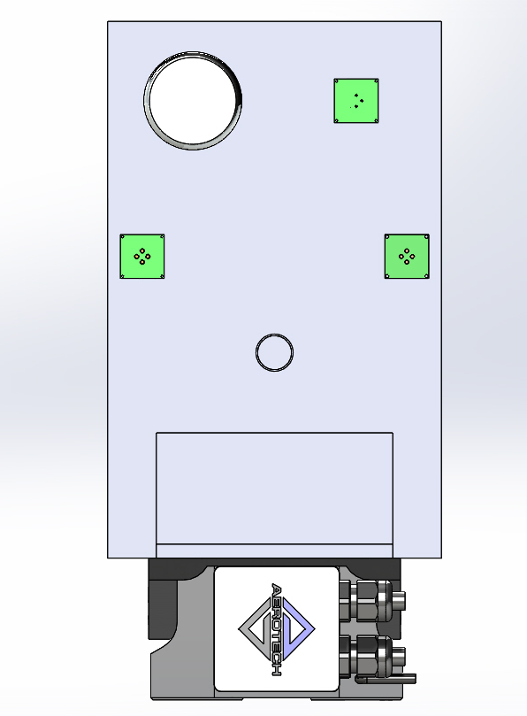
IR Sensor Plate Design Solution
DR 1.3.2 Satisfied
Integrated 4+ IR Sensors → 5 Sensors
3 sensors mounted to
printed circuit boards
2 Housed Sensors
6”
¼” Thick Al 6061 L Bracket
  Mounted to stager and IR sensor plate.
¼” HDPE IR Sensor Plate
Modular Design
Overview
Mechanical
Management
Sensor Selection
Thermal
Integration & Test
Electrical & Software

Slide 26
Distance Driving Requirements
DR 1.1 The distance between the target surface and non-contact infrared temperature sensor shall be adjustable.
  DR 1.1.1 Min Distance of ¼”.
  DR 1.1.2 Max Distance of 3”.
  DR 1.1.3 Distance variable in 3 incremental steps.
  DR 1.1.4 Accuracy of ±0.001”.
  Motivation: The intent is to determine whether distance is a contributing factor to temperature accuracy of the non-contact IR sensors.
Overview
Mechanical
Management
Sensor Selection
Thermal
Integration & Test
Electrical & Software

Slide 27
Linear Stage Mount Design Solution
 | Stage Provides | Required
Max Distance | 17.7” | 3”
Min Distance | 0” | 0.25”
Step Size | User defined | 3 steps
Accuracy | ±0.00023” | ±0.001”
¼” Thick HDPE IR Sensor Plate
Linear Stage (Provided By Ball)
¼” Thick Al 6061 L bracket
All Distance Requirements Satisfied
17.7”
Overview
Mechanical
Management
Sensor Selection
Thermal
Integration & Test
Electrical & Software
Notes:
Sasha: note, this trimetric view should be updated and include the HDPE baseplate

Slide 28
Target Rotation Driving Requirement
DR 1.3 Every IR sensor will be able to view every target surface.
  DR 1.3.1 Five target surfaces.
  DR 1.3.2 Four or more IR temperature sensors.
  Motivation: The intent is to determine how the IR sensors measure temperatures on different materials commonly found on spacecraft.
Overview
Mechanical
Management
Sensor Selection
Thermal
Integration & Test
Electrical & Software
Notes:
Sasha
More edits

Slide 29
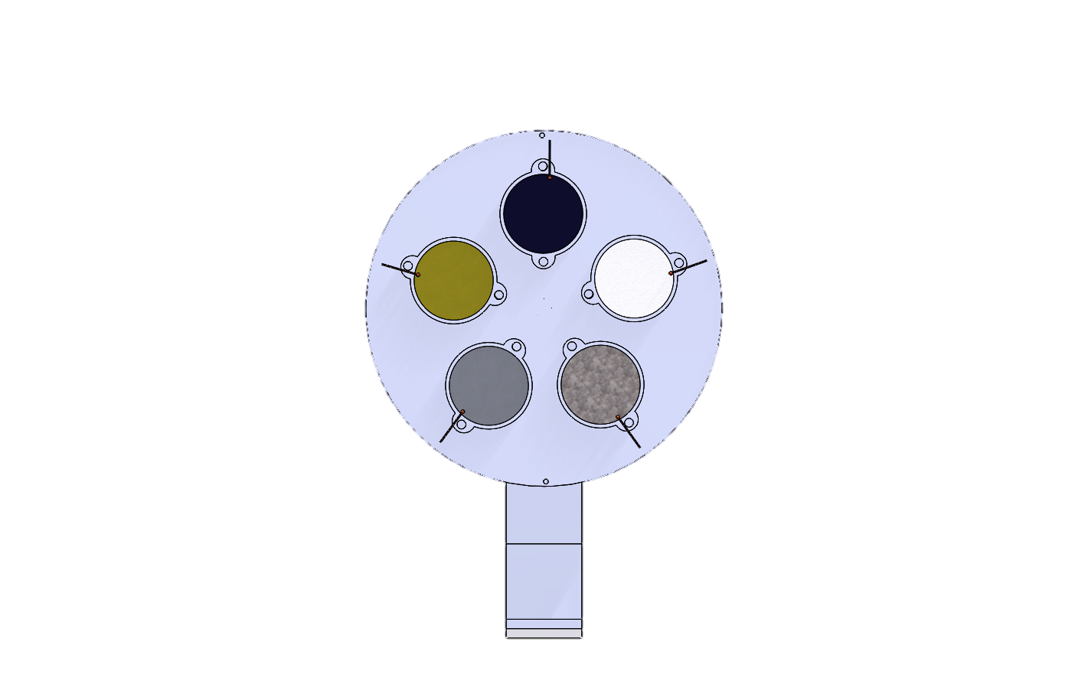
Target Wheel Design Solution
Al Target Wheel Diameter: 12”
Five Target Surfaces
  - Anodized Aluminum
  - Chromated Aluminum
  - Graphite Composite
  - Glass
  - Z306 Emissive Paint
Thermistors
Al 6061 “Picture Frame”
Plastic washer to secure
Thermistor to target surface
Target Surface
Diameter: 2.25”
Overview
Mechanical
Management
Sensor Selection
Thermal
Integration & Test
Electrical & Software

Slide 30
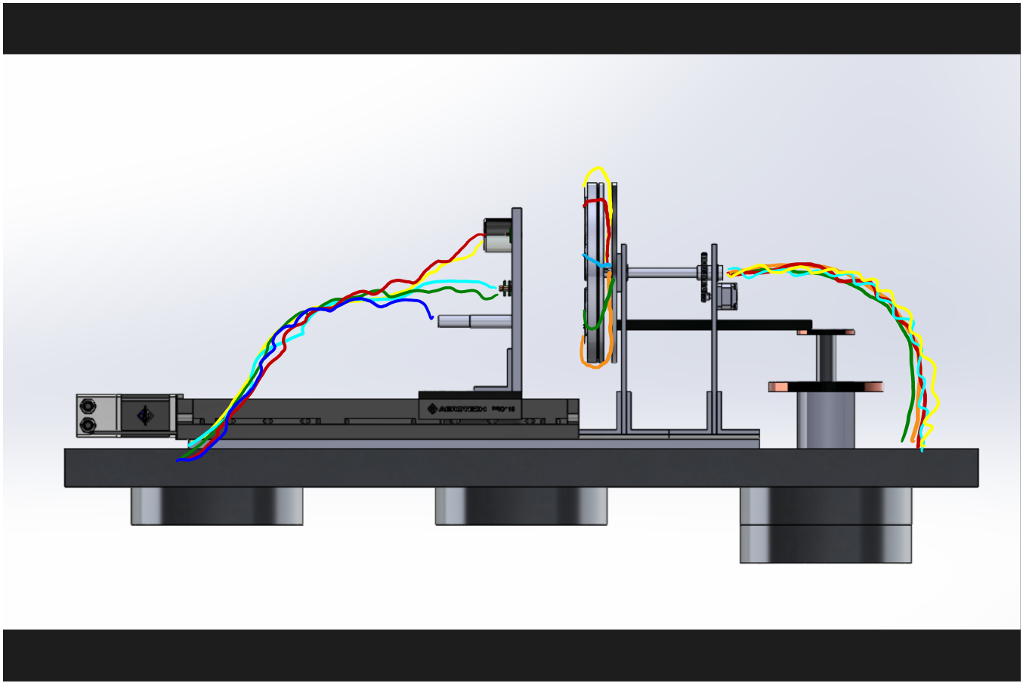
Target Wheel Design: Wire Management
All rotations will never exceed max 144° from neutral strain wire position
Thermistor wires go to a strain relief bracket
Thermistor wires come around the two target plates
10 thermistor wires +2 heater wires
enter the hollow axel via two slots
IR Temperature Sensor + Digital
Thermometer Wires
Bundled Wires leave
out the back
of the hollow
axle
Overview
Mechanical
Management
Sensor Selection
Thermal
Integration & Test
Electrical & Software

Slide 31
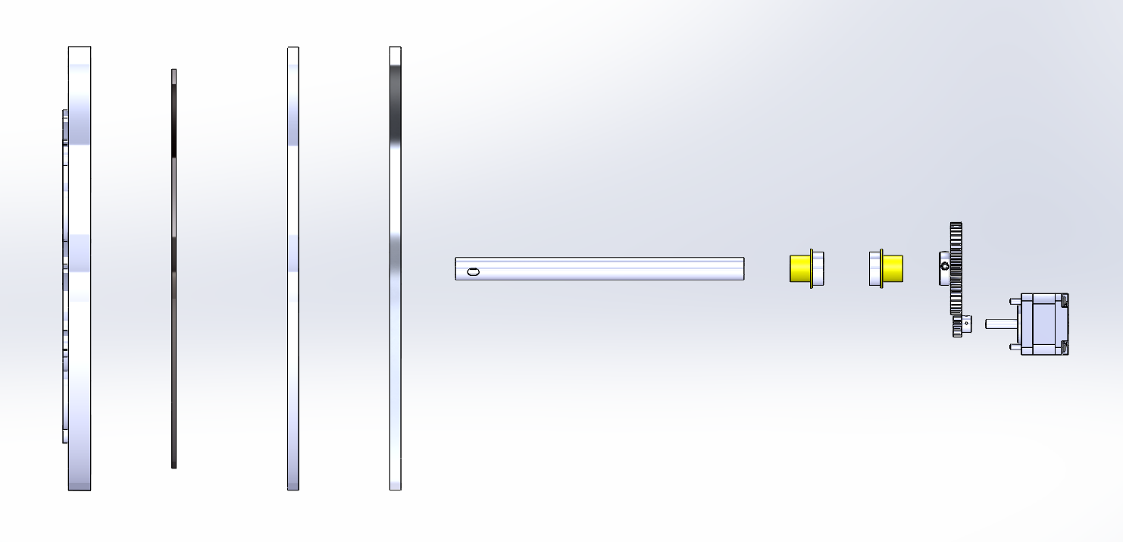
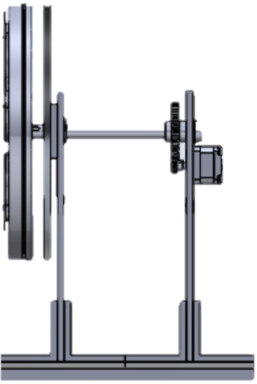
Target Wheel Design: Axle and Bearings
Expanded View
12” Al Target Wheel
Dry Contact Bearings
Full Assembly
Hollow 1” OD Delrin Plastic Axle
Arun C14.4 Step Motor (Provided by Ball)
9.5” Kapton Heater
12” Al Radiator
4:1 Gear Ratio
12” Al Backplate

Slide 32
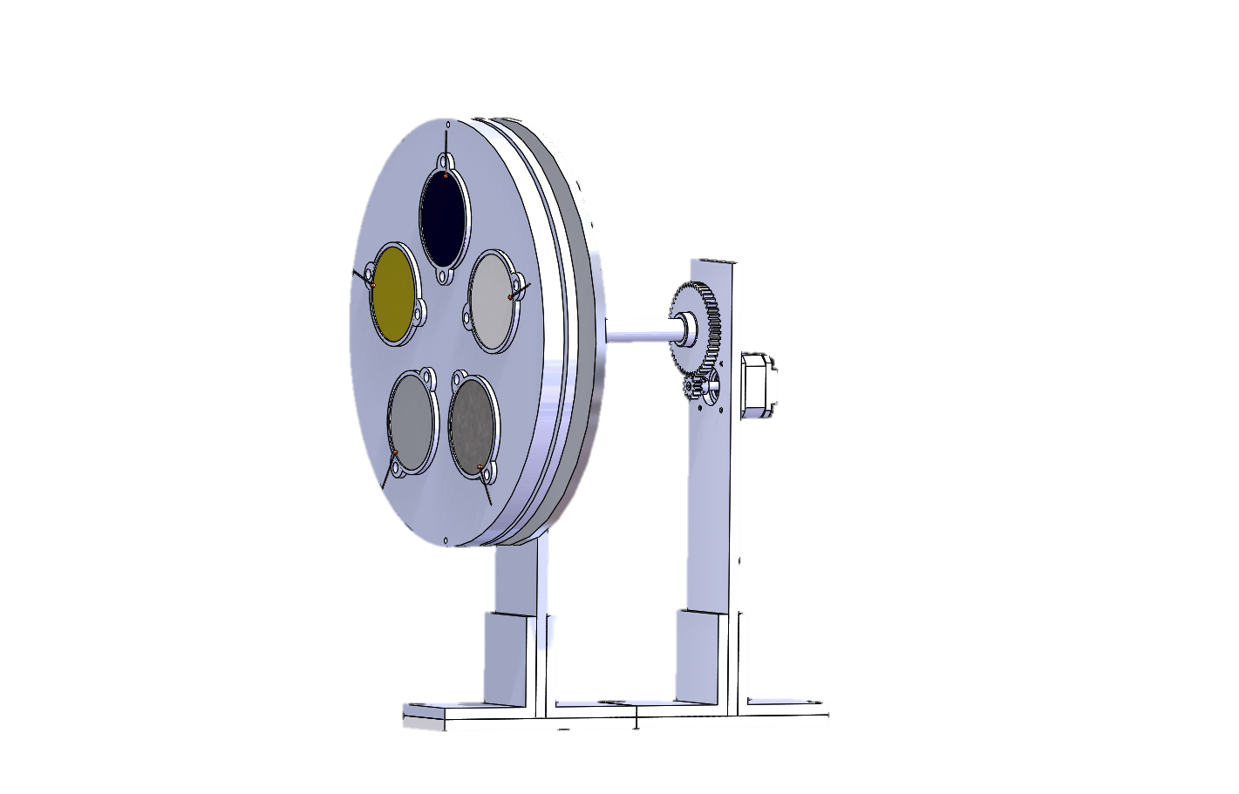
Target Wheel Design Solution:
Motor and Gears
Torque Supplied Arun C14.4 motor τ_{S}= 75 Nmm
Torque Required (I_{ST}, μ_{B}, design) τ_{R}= 97.8 Nmm
τ_{Required}> τ_{supplied}
GEARS REQUIRED
Gear Ratio 4:1; FOS =2.8; τ _{required}=24.2 Nmm
τ_{required}< τ_{supplied}
System can be rotated, DR 1.3 satisfied
72 degree rotation in 10 seconds

Slide 33
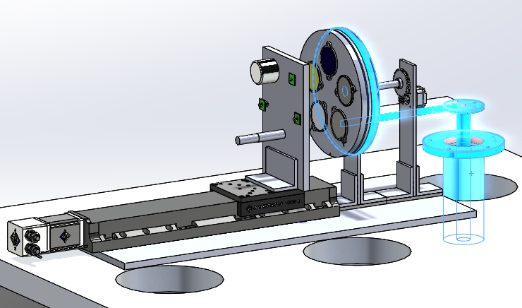
Thermal System
Goals:
Target Temperature Control
IR Sensor Survivability
Major Modifications from PDR:
Passive temperature control of IR sensors
Updated thermal rejection system
Overview
Mechanical
Management
Sensor Selection
Thermal
Integration & Test
Electrical & Software
Notes:
DAN

Slide 34
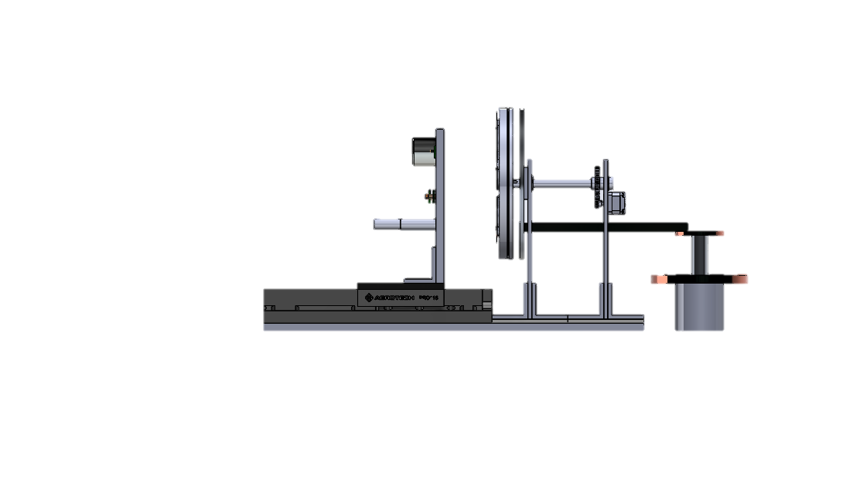
Temperature Control Driving Requirements
DR 3.2: The sensor plate shall be maintained within
275 – 325 K.
  Motivation: The intent is to maintain temperatures in a window within the operating range of each sensor.
DR 1.2.2: The target surfaces shall be controllable from
250 – 350K.
  Motivation: The intent is to sample temperatures within a range that components on a thermally controlled spacecraft will experience.
Overview
Mechanical
Management
Sensor Selection
Thermal
Integration & Test
Electrical & Software
Notes:
DAN

Slide 35
Thermal System Layout
Key:
Heater
Primary Conduction
Primary Radiation
Temperature Sensor
Patch Heater
Al Sensor Plate
275K < T_{sensors}<325K
Covered in Al Tape
Al Radiator Plate ~108K
1 Thermistor per Target
Copper Conducting Bar
GM Cooler 100K
(Provided by Ball)
Digital Thermometer
Covered in Al Tape
Al Target Wheel
250 – 350 K
Notes:
DAN

Slide 36
Heat Transfer Overview
Key:
Heater
Primary Conduction
Primary Radiation
Covered in Al Tape
q_{rad}
T_{s}>T_{t}
q_{rad}
q_{rad}
Covered in Al Tape
q_{cond}
Notes:
DAN

Slide 37

Heat Transfer Overview
Key:
Heater
Primary Conduction
Primary Radiation
q_{in}
q_{cond}
q_{cond}
q_{rad}
q_{cond}
q=heat rate (W)
q_{rad}
If T_{s}>T_{t}
q_{rad}
Target Wheel
Backplate
Radiator Plate
Heater
If T_{s}<T_{t}
q_{rad}
q_{rad}
Copper Conducting Bar
q_{cond}
GM Cooler
Notes:
DAN

Slide 38
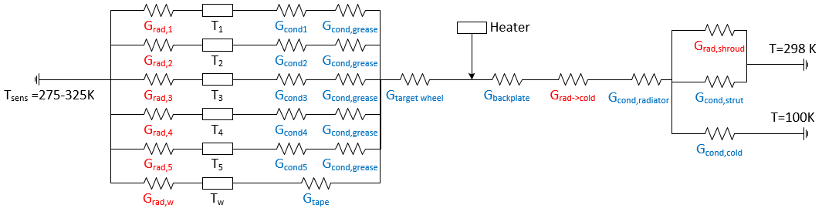

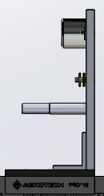
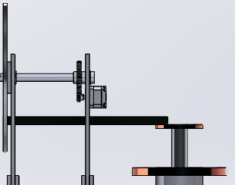
Thermal Circuit Overview
Radiation
Temps
Cond.
Paste
Shroud
G_{cond,strap}
Cold Finger
Sensorwheel
Radiation exchange
to radiator disk
Radiation exchange, sensors and targets
Conduction to/thru each target and remaining area
Assumptions:
1D heat transfer
Steady state
Boundary Conditions:
  Sensor Wheel: 275-325 K
  Cold Finger: 100 K
  Chamber Surroundings: 298 K
Key:
G = Conductance=1/R
Radiation G (W/K⁴)
Conduction G (W/K)
22 equations, 22 unknowns
MATLAB -> fsolve()
Notes:
DAN

Slide 39
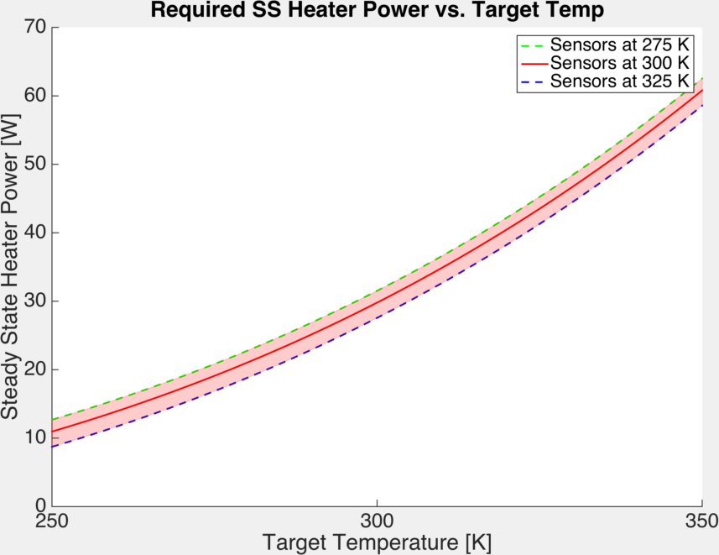
Heater Power Requirement Satisfaction
Method:
Set T_{target} → Calculate q_{heater}
62W
Conclusion:
62 W < 200 W budget
SS control of the targets can be achieved in range 250-350 K.
UltiBots 24V Kapton Heater:
Max Power: 300W; 1.07W/in²
Heater capable
* FOS of 4 on heater power required
Overview
Mechanical
Management
Sensor Selection
Thermal
Integration & Test
Electrical & Software
Notes:
DAN

Slide 40
Heat/Cool Rates Driving Requirements
DR 1.2.2.1 /2: The target surfaces shall increase in temperature at a minimum rate of 20K/hr and shall decrease in temperature at a minimum rate of 5K/hr.
  Motivation: The intent is to test the apparatus in the allotted time based on limited access to the thermal vacuum chamber.
DR 1.2.2.3 : The temperature of the target surfaces shall be modified in incremental steps of 10K.
  Motivation: The intent is to test the full range between 250K and 350K, determine if/when sensors begin to lose accuracy.
Overview
Mechanical
Management
Sensor Selection
Thermal
Integration & Test
Electrical & Software
Notes:
DAN

Slide 41
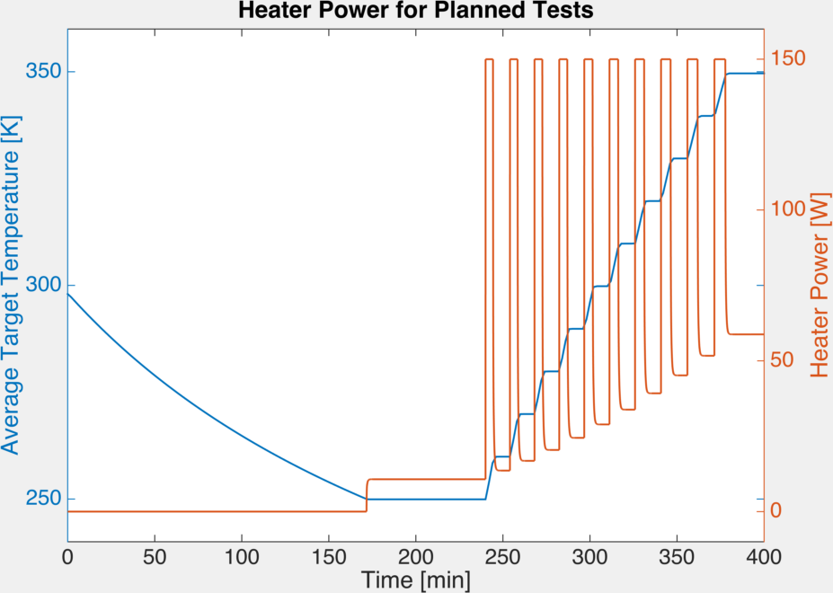
Heat/Cool Rate Requirement Satisfaction
Requirement Satisfaction:
Cool Down:
-16.5 K/hr < -5 K/hr
Satisfies DR 1.2.2.2
Max Heat up:
+100 K/hr > +20 K/hr
For steps of 10 K
Satisfies DR 1.2.2.1/3
Cool down= 2.9 hrs
Max heat up
6 min
Finish Pump Down
Test (x11)+ Heat up(x10)
Overview
Mechanical
Management
Sensor Selection
Thermal
Integration & Test
Electrical & Software
Notes:
DAN

Slide 42
Sensor Operating Range
Driving Requirements
DR 3.2 : The sensor plate shall be maintained within the temperature range of 275 - 325K.
  Motivation: The intent is to maintain temperatures in a window within the operating range of each sensor.
Overview
Mechanical
Management
Sensor Selection
Thermal
Integration & Test
Electrical & Software
Notes:
DAN

Slide 43
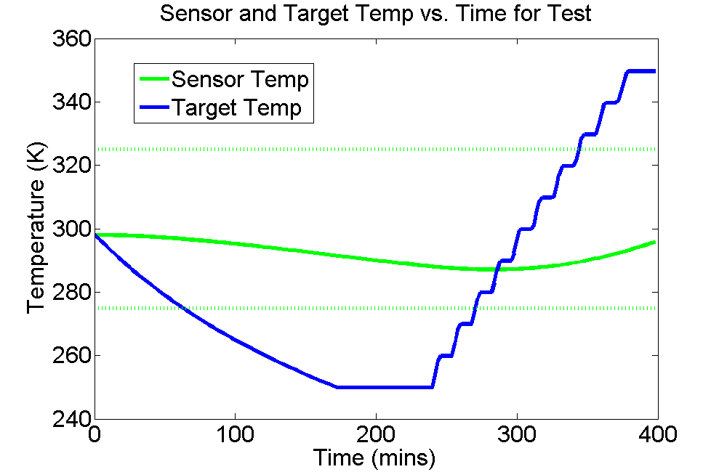
Predicted Sensor and Target Temperatures vs. Time
Requirement Satisfaction:
Sensor Temperature:
T_{sensor} ≤ 298K < 325K
275K < 286K ≤ T_{sensor}
Meets DR 3.2
(275K<T_{sensor}<325K)
10 K steps
Sensor Operating Range
Finish Pump Down
Cool down
Tests (x11)+Heat up(x10)
Overview
Mechanical
Management
Sensor Selection
Thermal
Integration & Test
Electrical & Software
Notes:
DAN

Slide 44
Temperature Accuracy Driving Requirements
DR 2.1.2 : The absolute temperature of the targets shall be collected with an accuracy of 1K or better.
  Motivation: The intent is to have a reliable measurement within 10% of the temperature change described in DR 1.2.2.3 from which to compare temperature data.
Overview
Mechanical
Management
Sensor Selection
Thermal
Integration & Test
Electrical & Software
Notes:
Dylan

Slide 45
Radial Gradient Concerns
Thermistor
ΔT must be <1K in order to satisfy DR 2.1.2 such that the thermistors and IR sensor are reading a consistent temp of the target.
ΔT
Overview
Mechanical
Management
Sensor Selection
Thermal
Integration & Test
Electrical & Software

Slide 46
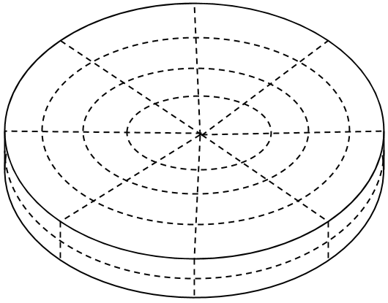
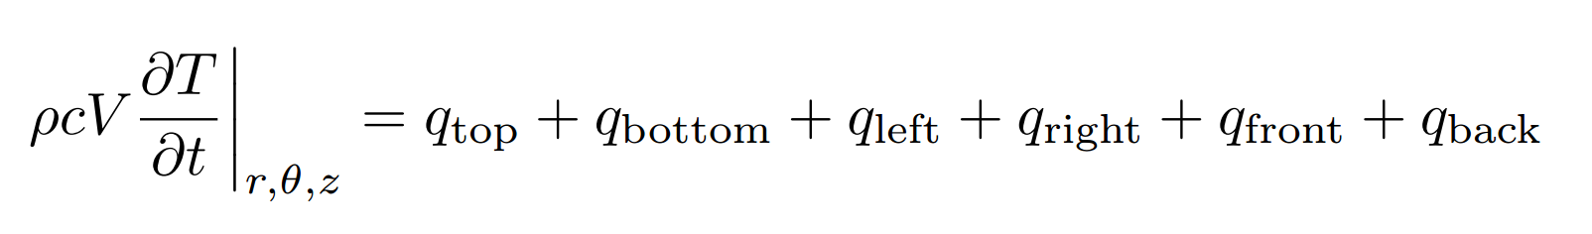
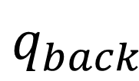
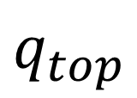
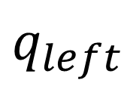

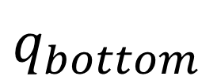

3D Model Methodology
r
$$q_{top}$$
z
$$q_{back}$$
$$q_{left}$$
$$q_{right}$$
$$q_{front}$$
$$q_{bottom}$$
Overview
Mechanical
Management
Sensor Selection
Thermal
Integration & Test
Electrical & Software

Slide 47
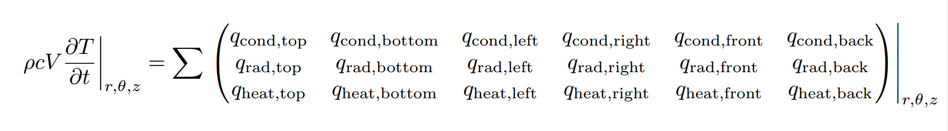
3D Model Methodology cont.
Overview
Mechanical
Management
Sensor Selection
Thermal
Integration & Test
Electrical & Software

Slide 48
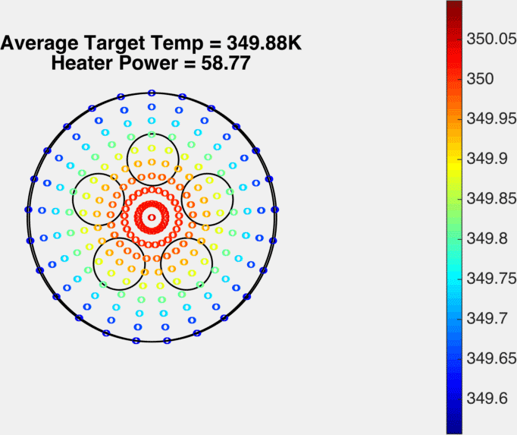
Radial Gradient Requirement Satisfaction
W
ΔT (K)
ΔT=0.2<0.5K*
DR 2.1.2 Satisfied
*Due to electrical considerations discussed later this must be 0.5K as opposed to 1K

Slide 49
Electrical & Software
Goals:
Data Acquisition
Control Implementation
Data Storage
Major Modifications from PDR:
All electronics outside TVAC

Slide 50
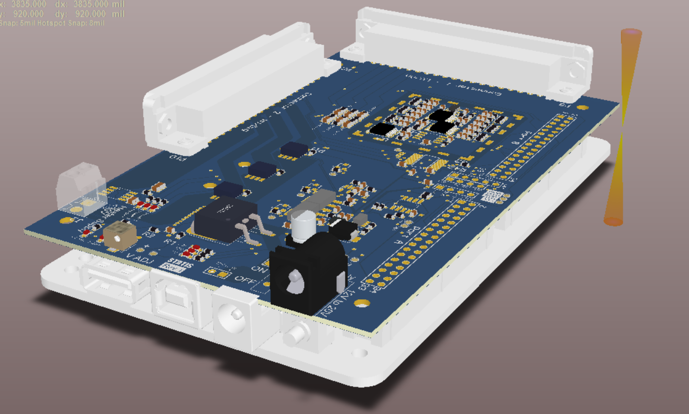
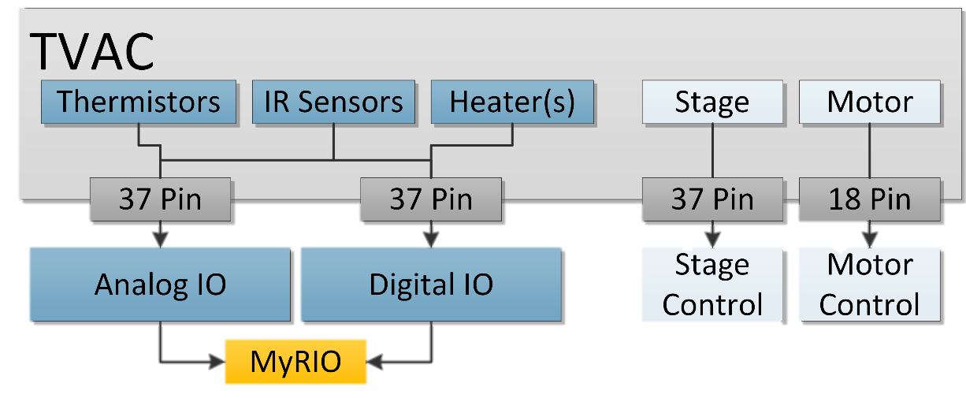
Hardware Overview
NI MyRIO Embedded Platform
Custom board to stack on top of MyRIO
  ADCs
  Heater control
  IR Sensor Input
Cable Harnessing
  Interface with TVAC 37-pin
  Internal boards handle sensor and
  heater interface
Custom PCB
NI myRIO

Slide 51
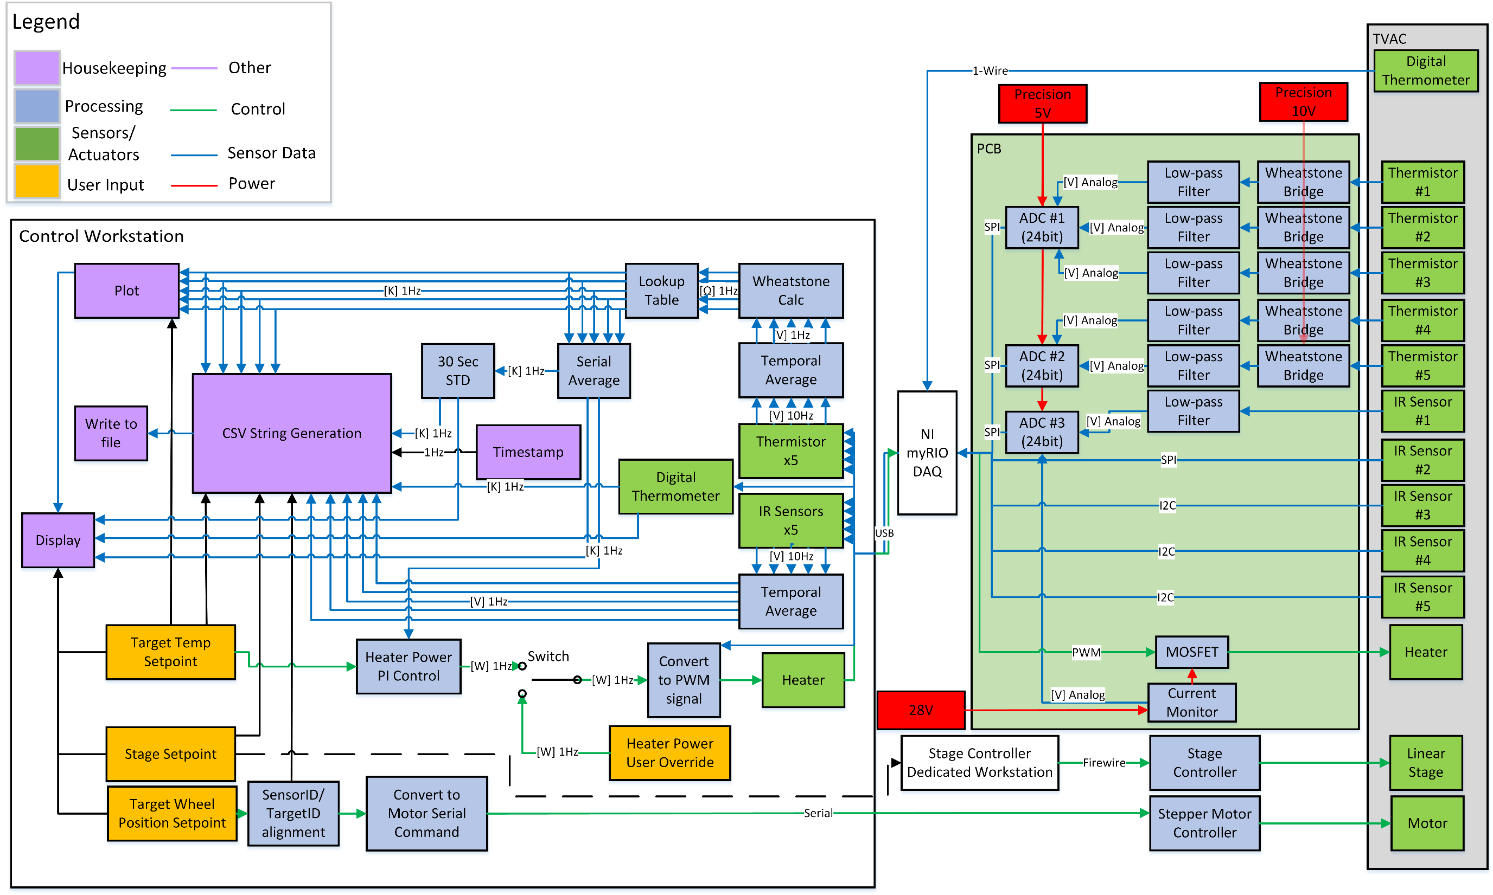
Electrical/Software Overview
Electrical & Software FBD
Overview
Sensor Selection
Summary
Requirements
Mechanical
Electrical
Thermal
51
Notes:
Microcontroller external to TVAC
ADC internal to TVAC to reduce signal noise
Stage control handled by separate controller

Slide 52
Electrical/Software Overview
Overview
Sensor Selection
Summary
Requirements
Mechanical
Electrical
Thermal
52
Notes:
Microcontroller external to TVAC
ADC internal to TVAC to reduce signal noise
Stage control handled by separate controller

Slide 53
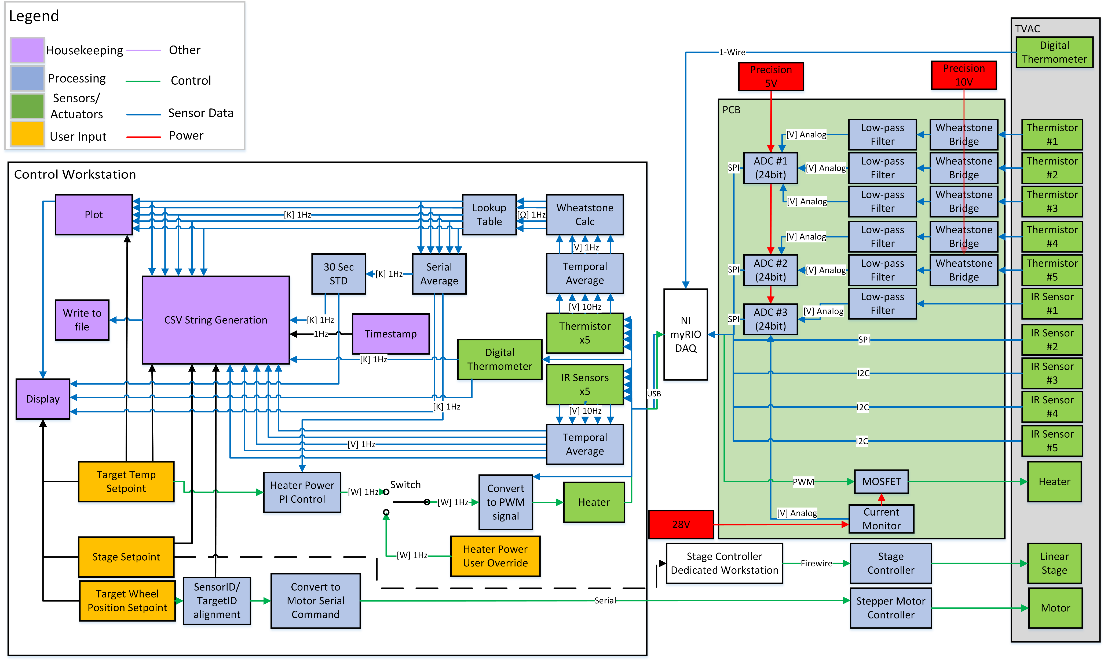
Electrical/Software Overview
Overview
Sensor Selection
Summary
Requirements
Mechanical
Electrical
Thermal
53
Notes:
Microcontroller external to TVAC
ADC internal to TVAC to reduce signal noise
Stage control handled by separate controller

Slide 54
Reference Temperature
DR 2.1 – Temp collected by conventional contact sensors for reference
DR 2.1.2 – Reference temp accuracy of 1K or better
Design Solution:
Thermistor measurement error less than 0.5K (calibrated).
Includes resistor tolerances, source precision, and parasitics.
DR 1.2.1 – Reference temp STD < 0.1K over 30 sec
Design Solution:
Electrical noise less than 0.02K (including LPF).
Includes capacitive, inductive, and radiative coupling from noise sources.
Overview
Sensor Selection
Summary
Requirements
Mechanical
Electrical
Thermal
54
Notes:
Microcontroller external to TVAC
ADC internal to TVAC to reduce signal noise
Stage control handled by separate controller

Slide 55
Electrical/Software Overview
Temperature Conversion
DR 2.1.1 – Target temps collected at 1Hz
DR 1.2.1 – Reference temp STD < 0.1K over 30 sec
Overview
Sensor Selection
Summary
Requirements
Mechanical
Electrical
Thermal
55
Notes:
Microcontroller external to TVAC
ADC internal to TVAC to reduce signal noise
Stage control handled by separate controller

Slide 56
Electrical/Software Overview
DR 1.2 – Temperature control through user commands.
Heater Control
Overview
Sensor Selection
Summary
Requirements
Mechanical
Electrical
Thermal
56
Notes:
Microcontroller external to TVAC
ADC internal to TVAC to reduce signal noise
Stage control handled by separate controller

Slide 57
Electrical/Software Overview
MOSFET Circuit
DR 1.2.1 – Reference temp STD < 0.1K over 30 sec
Analysis: System allows for 40mW step size in heater power.
Overview
Sensor Selection
Summary
Requirements
Mechanical
Electrical
Thermal
57
Notes:
Microcontroller external to TVAC
ADC internal to TVAC to reduce signal noise
Stage control handled by separate controller

Slide 58
Electrical/Software Overview
DR 1.1 – Distance control via user input commands.
Mechanical Control
DR 1.3 – Measure all target surfaces with all IR sensors.
Overview
Sensor Selection
Summary
Requirements
Mechanical
Electrical
Thermal
DR 2.3 – Correlate sensor–target pairing to data sets.
58
Notes:
Microcontroller external to TVAC
ADC internal to TVAC to reduce signal noise
Stage control handled by separate controller

Slide 59
Electrical/Software Overview
Mechanical Actuators
Overview
Sensor Selection
Summary
Requirements
Mechanical
Electrical
Thermal
59
Notes:
Microcontroller external to TVAC
ADC internal to TVAC to reduce signal noise
Stage control handled by separate controller

Slide 60
Electrical/Software Overview
IR Sensor Interface
DR 1.3.2 – 5 different IR sensors
Design flexibility for IR sensor compatibility:
0.8V to 12V supply voltage
SPI/I2C Digital interface
Analog Voltage or Current interface
Thermopile interface w/ internal converter
Overview
Sensor Selection
Summary
Requirements
Mechanical
Electrical
Thermal
60
Notes:
Microcontroller external to TVAC
ADC internal to TVAC to reduce signal noise
Stage control handled by separate controller

Slide 61
Electrical/Software Overview
Down Sampling
Overview
Sensor Selection
Summary
Requirements
Mechanical
Electrical
Thermal
Notes:
Microcontroller external to TVAC
ADC internal to TVAC to reduce signal noise
Stage control handled by separate controller

Slide 62
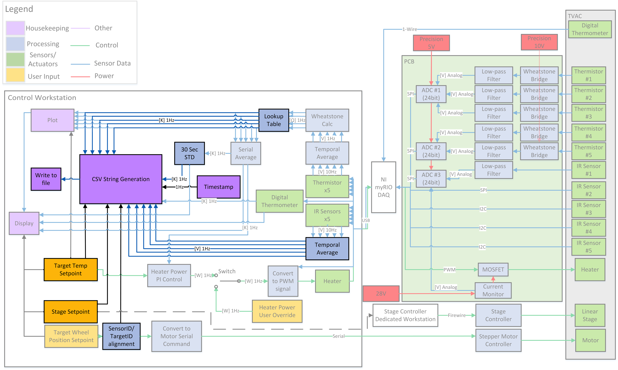
Electrical/Software Overview
Data Output
DR 2.4 – Save data to output file
DR 2.5 – Data time stamping and measurement correlation to 1sec
5ms
Data Processing and File Write
1ms
ADC Read
2ms
IR Sensor Read
<10x FOS for timing
Offramp - FPGA for data acquisition and timestamping
Overview
Sensor Selection
Summary
Requirements
Mechanical
Electrical
Thermal
62
Notes:
Microcontroller external to TVAC
ADC internal to TVAC to reduce signal noise
Stage control handled by separate controller

Slide 63
Integration & Test
Goals: Mitigate and expose risks by assembling and testing systems
Overview
Mechanical
Management
Sensor Selection
Thermal
Integration & Test
Electrical & Software
Notes:
Talk about how component tests will be done and how all purchased or provided equipment will be checked for functionality prior to systems level testing.

Slide 64
Overview of Subsystem Checkouts
Purchased/Provided Part Functionality
  Heater
  Linear Stage
  Motor
  Sensors
Subsystem Checks
  Electrical Checkouts
  Software Testing
  Mechanical Tolerance Checks
Overview
Mechanical
Management
Sensor Selection
Thermal
Integration & Test
Electrical & Software

Slide 65
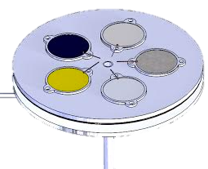
T1: Ambient Thermal Test
Main Objective: Show functionality and commandability of thermal system.
Requirements Verified:
  1.2.1 STD of target temp <0.1K over 30s
  1.2.2 Target temps commandable to 250-350K in 10K intervals
Location: CU Campus
General Procedure: Command temp to greater than ambient temperature and verify stability of 0.1K STD
Required Systems:
Target Wheel
5x Installed Thermistors
Heater
Radiator Plate
12”
Heater Control
Software
Overview
Mechanical
Management
Sensor Selection
Thermal
Integration & Test
Electrical & Software

Slide 66
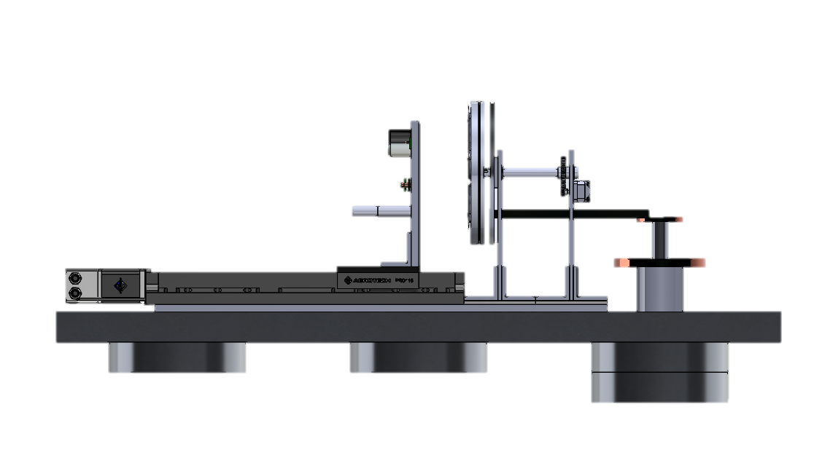
T2: Alignment Test
Main Objective: Ensure FOV of IR sensors are on targets
Requirements Verified:
  2.3 Known combination of sensor and surface
  1.3 Every target will see every IR sensor
  1.3.1.1 Target area shall be big enough for FOV
Location: Ball facilities – Ambient
General Procedure: At the furthest difference with heaters on, test to make sure that FOV is on the target by introducing a surface cooled with liquid nitrogen in front of target and around target.
Required Systems:
Target Wheel & Heater
IR Sensor Plate
Motor
Stage
Stage Control
Software
48”
Overview
Mechanical
Management
Sensor Selection
Thermal
Integration & Test
Electrical & Software

Slide 67
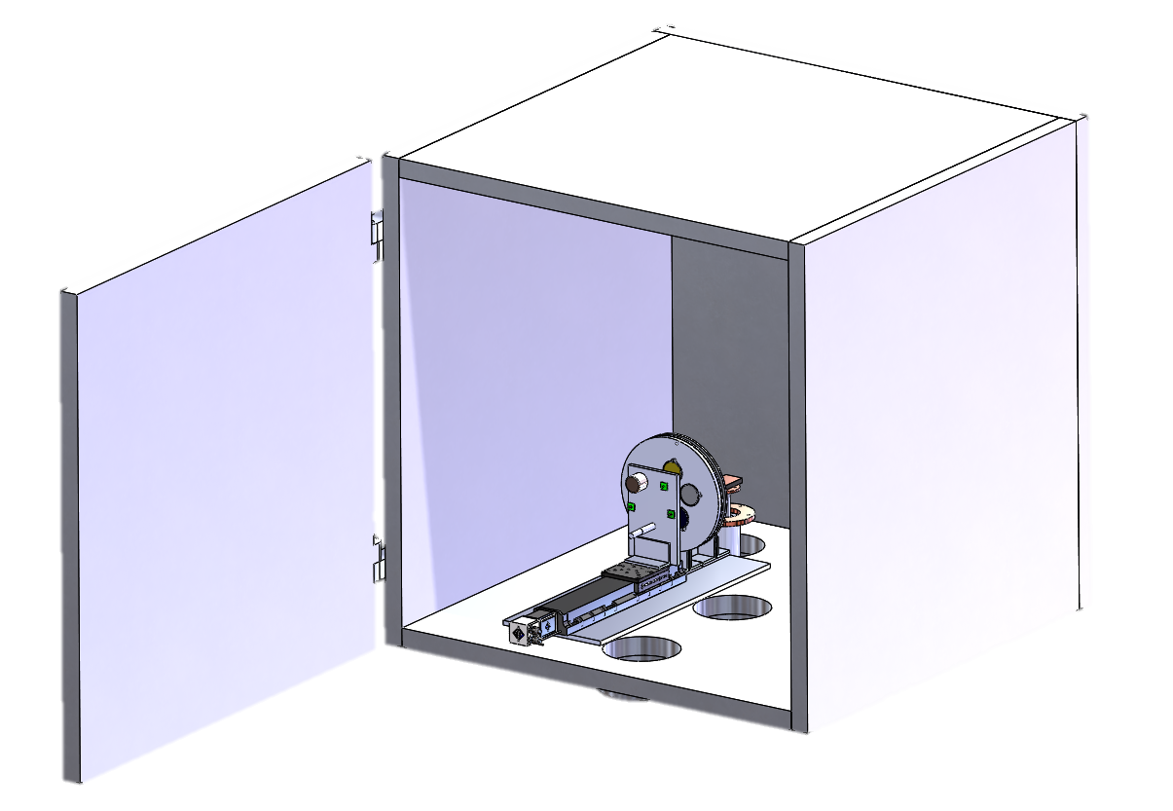
T3: STATIS Full System Test
AMBIENT
Main Objective: Run entire testing cycle at ambient to show functionality and chamber compatibility.
Location: Ball TVAC – No change in pressure (5 day test window)
Action Items for Failed Test:
  Dependent on failed systems
  Cannot depressurize in TVAC without passing ambient test
Required Systems: All
STATIS
Thermally Strapped
Ambient Pressure TVAC
Overview
Mechanical
Management
Sensor Selection
Thermal
Integration & Test
Electrical & Software

Slide 68
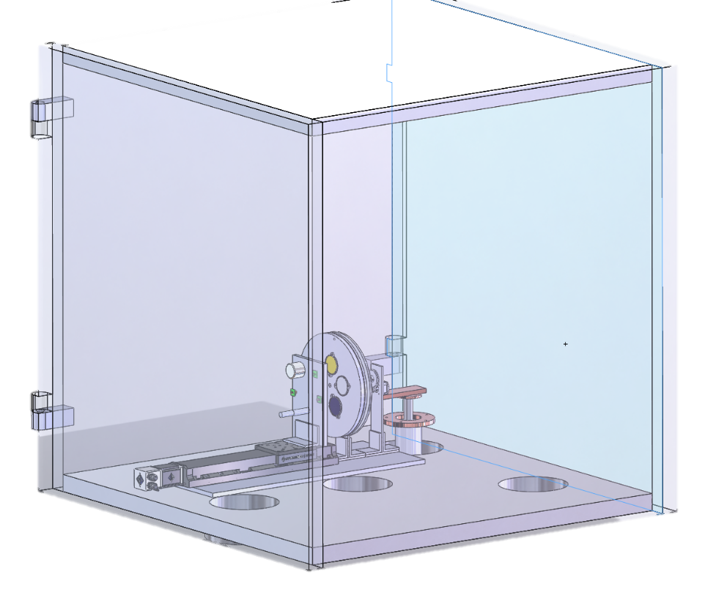
T4: STATIS Full System Test
TVAC
Required Systems: All
Main Objective: Run entire testing cycle in TVAC to show complete functionality before handing test bed over to Ball.
Location: Ball TVAC 10e-7 Torr
(Additional 5 day test window)
Action Items for Failed Test:
  Dependent on failed systems
  Cannot reach top level success without passing TVAC test
Thermal Strapped
STATIS
Depressurized TVAC
Overview
Mechanical
Management
Sensor Selection
Thermal
Integration & Test
Electrical & Software

Slide 69
Management
Major Takeaway:
On Schedule
On Budget
Overview
Mechanical
Management
Sensor Selection
Thermal
Integration & Test
Electrical & Software
Notes:
Maria

Slide 70
Organizational Chart
STATIS
Customer
(Ball Aerospace – Joe Lopez)
ADVISOR
Jeliffe Jackson
Project Manager
(Maria Rocco)
Systems Engineer
(Ashley Zerr)
Integration and Test
(Sarah Wilson)
Financial
(Smith Johnston)
Safety
(Sarah Wilson)
Sensor Selection
(Smith Johnston)
Mechanical
(Alexander Potter)
Manufacturing
(Daniel Flora)
Thermal
(Cameron Comeau)
Electrical
(Evan Schomer)
Software
(Dylan Stewart)
Overview
Mechanical
Management
Sensor Selection
Thermal
Integration &Test
Electrical & Software
Notes:
Point out technical leads

Slide 71
Work Breakdown Structure
STATIS
Course Deliverables
Management
Integration & Test
Mechanical
Thermal
Electrical &
Software
CDR
Schedule
V&V Test Plans
CAD model
1D Model
Trade Study - DAQ
FFR
Risk Matrix
Data
Component Selection
Quasi 3D Model
Board Schematic
MSR
WBS
Time
3 Plates/Disks
Component Selection
Component Selection
Distance
TRR
Budget
ID’s
Sensor Housing
Insulation Design
I/O Software FBD
AIAA paper
Procured Parts
Temperature
Attachment Mechanism
Ambient Test
Complete
Hardware Sys.
SFR
TVAC Test
LEGEND
Software Executable
PFR
Test Reports
Complete at CDR
Incomplete at CDR
Overview
Mechanical
Management
Sensor Selection
Thermal
Integration & Test
Electrical & Software
Notes:
What are key products that will be most critical to produce

Slide 72
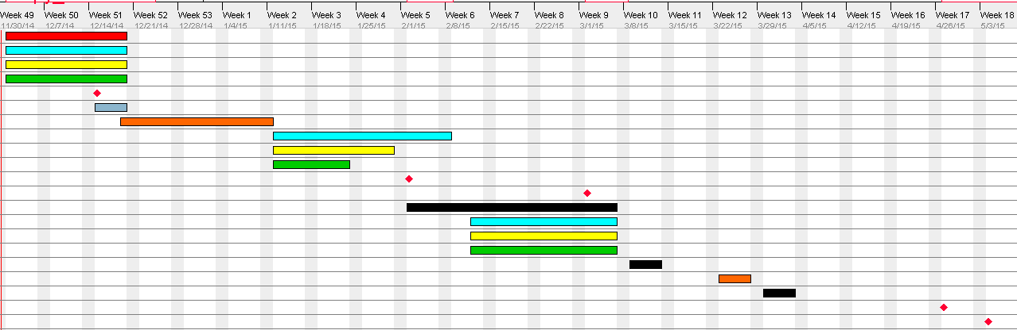
Schedule Overview
Week 1
Week 10
Week 17
Finalize All Models
Thermal
Mechanical
Electrical
Software
Finance
Holidays/Breaks
Testing
Milestone
Margin
Ambient Test (at Ball)
Manufacturing, Part Population, Software Development
FFR
Final Test (at Ball)
Winter Break
MSR
TRR
Component and Integration Testing
Bakeout Session (at Ball)
Ambient Test
Spring Break
Final Vacuum Test
SFRx2
Overview
Mechanical
Management
Sensor Selection
Thermal
Integration & Test
Electrical & Software
Notes:
Maria

Slide 73
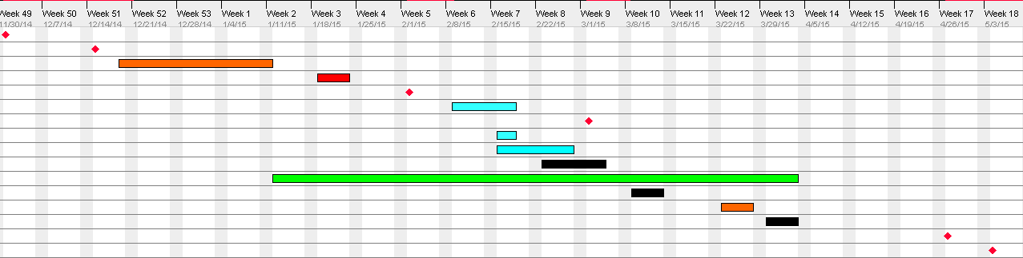
Test Schedule
Week 1
Week 10
Week 17
CDR
Component and Distance Tests
Final Test (at Ball)
Bakeout
Subsystems
Component
Multi-System
Milestone
Margin
FFR
Ambient Test (at Ball)
MSR
TRR
Ambient Thermal Test
Alignment Test (at Ball)
Bakeout Session (at Ball)
Full Ambient Test (at Ball)
SFR
SFR
Full TVAC Test (at Ball)

Slide 74


Budget
Thermal
5%
$312
Testing
6%
$420
Overview
Mechanical
Management
Sensor Selection
Thermal
Integration & Test
Electrical & Software
Notes:
Maria
Smith

Slide 75
CDR Risk Matrix
Thermal modeling fidelity
  Additions to model to improve fidelity
Access to Ball’s facilities and hardware
  More hardware guaranteed
  Direct correspondence with TVAC manager
Prove temp control system is capable of meeting requirements
  Built in margins of error in other systems
Purchasing schedule risk (order/delivery time frames)
  Obtained A-Card
 | 3
 | 2 | 1
 | 4
3
High
1
Importance
2
4
Low
Low
Probability of Failure
High
Indicates Risks at PDR

Slide 76
Pre-Test Risk Matrix
Thermal modeling accuracy
  No change
Access to Ball’s facilities and hardware
  Should already have facility access
Prove temp control system is capable of meeting requirements
  No change
Purchasing schedule risk (order/delivery time frames)
  All parts should be ordered and installed
 | 3
2 |  | 1
4
3
High
2
1
Importance
4
Low
Low
Probability of Failure
High
Indicates Risks at CDR

Slide 77
Summary
5 Targets: Anodized Al, Chromated Al, Glass, Graphite composite, Emissive Paint (Provided by Ball)
Al
24V Kapton Heater
5 IR Sensors: OS36, TPT, MLX-BAD, MLX-B, MLX-A
4:1 Gears
Arun C14.4 Motor (provided by Ball)
HDPE Plastic
Aerotek Pro 115 Linear Stage (provided by Ball)
Copper Conducting Bar
GM Cooler (provided by Ball)
TVAC Floor
HDPE Plastic
HDPE Plastic
Notes:
How does this satisfy major requirements

Slide 78
Questions?

Slide 79
Backup Slides

Slide 80

Functional Block Diagram Original
PDR
Overview
Mechanical
Management
Sensor Selection
Thermal
Testing & Integration
Electrical & Software
Notes:
Dylan

Slide 81

Functional Block Diagram
PDR
Redesigns
Overview
Mechanical
Management
Sensor Selection
Thermal
Integration & Test
Electrical & Software
Notes:
Dylan

Slide 82
Sensor Selection Backup

Slide 83
Sensor Selection Trade Study
# | Sensor | FOV | Cost | Mechanical Considerations | Electrical Considerations
1 | OS36-3-T-50F | 17deg | $389 | Housing already built and Compatible
2 | MLX90614KSF-ACC | 35deg | $26.32 | Manufacture Cylindrical Housing
5 | MLX90614ESF-BCF | 10deg | $27.22 | Manufacture Cylindrical Housing
4 | MLX90620ESF-BAD | 40deg | $75.62 | Manufacture Cylindrical Housing
3 | TPT300V | 5.5deg | $375.51 | Manufacture Cylindrical Housing
 | PSC-SSS | 3deg | $815 | Housing already built and Compatible | Cannot use without Electronics Box (not vacuum compatible)
 | OS36-3-K-1200F | 17deg | $1,035 | Bulky Housing
 | CT-SF02-C1 | 27deg | $505 | Housing already built and Compatible | Cannot use without Electronics Box (not vacuum compatible)
 | ZTP-115M | 5.5deg | $13 | Geometrically awkward - Not simple design solution
 | ZTP-115 | 50deg | $5 | Manufacture Cylindrical Housing
Overview
Mechanical
Management
Sensor Selection
Thermal
Testing & Integration
Electrical & Software
Notes:
Smith

Slide 84
Mechanical Backup

Slide 85


Shaft Bending Stress and Deflection
Bending stress of cantilevered beam:
The load F = 36.8 N (weight of target disks)
For Delrin: Tensile Strength = 36 MPa
Bending Stress Safety Factor: 41
Deflection of cantilevered beam:
For Delrin: E = 2.4 GPa
0.000006 m = 0.00024”
Allowable 0.06” > 0.00024”
856 kPa
0.000006 m
Notes:
Sasha

Slide 86

Shaft Shear Stress
F = 36.8 N (weight of target disk assembly)
A = 0.000222 m²
For Delrin: shear strength = 35.8 MPa, which gives
a safety factor of 215.
Shear stress on hollow shaft cross section

Slide 87

Thermal Contraction: Shaft, Bearings, Supports
Using Linear expansion, where the starting lengths are the thicknesses in the radial direction, and further assuming
that all the components reach the
radiator temperature of 100K:
Total Contraction = 0.0017”
0.06”> 0.0017”
-193 K
Delrin Shaft, Thermal Expansion = 16*10⁻⁶ m/(mK)
Initial Length = 0.125”
Support, Thermal Expansion = 12*10⁻⁶ m/(mK)
Initial Length = 0.5”
Bearing, Thermal Expansion = 9.9*10⁻⁶ m/(mK)
Initial Length = 0.0625”

Slide 88

Inertia, Motor and Gears
Gear Radius
Contact Force Pair
Contact Force Pair
Pinion Gear Radius
r1
F
-F
r2
Pinion/Gear Schematic
Gear Ratio
Torque Supplied by Motor (70 mNm)

Slide 89





Inertia, Motor and Gears Continued
Normal Reaction Forces on
Supports (45N and 5.6 N)
Determined with moment
and force balance.
Radius of Shaft:
0.5”
Coefficient of Static Friction:
0.15
72 degree rotation
in 10 seconds
To deliver this requires a gear ratio of 1.4,
a gear ratio of 4 gives a factor of safety of 2.8.

Slide 90
Bearing Stresses
The contact areas between the
shaft and support structure carry
bearing stresses. The larger of the
two (45 N compared to 5.6 N) is
highlighted here.
F (reaction force)
b (hole diameter)
b=1”
A=0.000323 m²
t (hole depth)
t=1/2”
For the Delrin Shaft, Compressive strength = 35.8 MPa, this gives a safety factor of 256.
For the iGlideJ, permissible surface pressure = 35 MPa, which gives a factor of safety of 250.

Slide 91

Support Compressive Stress
45 N
The HDPE supports experience compressive (front) and
tensile (rear) stresses due to the weight of the Delrin shaft and
the target disk assembly.
A = width*thickness = 0.00065 m²
= 69 kPa
Height = 10”
For HDPE, compressive strength = 20.6 MPa,
this gives a safety factor of 298.
Thickness = ½’
Width = 2”

Slide 92


Compressive Buckling
P = 45 N
The HDPE supports are only ½” thick, thus, buckling was a possible concern.
From Euler Pre-Buckling Theory
the critical load is given by:
For a rectangular cross section:
Height L = 10”
For HDPE, E = 0.883 GPa
This gives a critical load P_{cr} = 1171 N.
The supports experience a maximum of 45 N.
This gives a safety factor of 26.
Thickness t = ½”
Width b = 2”

Slide 93



Wire Clearances
Orignially, the design was ¼” diameter shaft, this could not fit all the wires.
Then ½” diameter shaft was investigated, and the fit was too tight.
1” provides plenty of clearance.
Heater wire
To get into the hollow shaft, the 10 thermistor
wires pass through slots cut in the shaft and
the rear target attachment plate.
Slots for Wires (4)
1/5”x1/5”
½” diameter shaft
1” diameter shaft
Thermistor wire
Front Target
Disk
Holes for set pin (4)
(expanding “C” clamp)
1/8” diameter
Target Plate/Shaft Attachment and Wire Slots
Hollow Shaft

Slide 94

Wire Strain Relief Brackets
The two heater wires come out of the center of the hollow shaft, so they may pass straight
down the length of the shaft (directly off of the back of the front target disk).
The thermistor wires, however, must go around both the front and rear target disks to then
pass into their slots and go down the shaft, so they must have strain relief, so that any tension
in the wires from twisting is not concentrated at the thermistors attachment point.
Hollow Shaft
¼” thick Aluminum Strain Relief
Brackets (tension from rotation
taken here)
1/5”x1/5” Slots for wires
entrance into hollow shaft.
Back of rear target disk
Thermistor wire pairs

Slide 95
Thermal Backup

Slide 96
Target Temp Residuals
Difference in temp of each target due to material properties very small, glass only outlier
Overview
Sensor Selection
Summary
Requirements
Mechanical
Electrical
Thermal

Slide 97
Steady State Heat Loads
Dominant heat path:
Heater power radiates to radiator disk, conducts to cooler. Radiation with shroud and between sensors/targets is very small
Overview
Sensor Selection
Summary
Requirements
Mechanical
Electrical
Thermal

Slide 98
Distance Comparison
Difference between heater power for each distance is very small.
The radiation path between targets and sensors has very small contribution
Overview
Sensor Selection
Summary
Requirements
Mechanical
Electrical
Thermal

Slide 99
Distance Comparison
Running cooler at 100 K will give 350 W of lift capacity.
350 W >> 65 W max
(65 W needed for 350K steady state)
Overview
Sensor Selection
Summary
Requirements
Mechanical
Electrical
Thermal

Slide 100

Quasi-Equilibrium Analysis
Sequence:
Cool Down at 250 K @ max distance
Maintain steady state 250 K for rest of pump down
Perform steady state 190 sec test for distances 1, 2, 3
Heat up target 10 K to next SS temp @ distance 3
Flow diagram of what we did? How is analysis different? “Same” model is being used but the APPLICATION of the model is different. So show this not the circuit diagram
Circuit diagram looks the same so do something to show this variation
Notes:
DAN

Slide 101
Sensor Temp Limits
End of pump
End of tests
9.8 hrs
6.8 hrs
After 4 hr pump down, 9.8 hrs of 250 K before T_{sens}<275 K
Equilibrium: T_{sens}=268 K
After 1 full test cycle,6.8 hrs of 350 K before T_{sens}> 325 K
Overview
Sensor Selection
Summary
Requirements
Mechanical
Electrical
Thermal
Notes:
This is a backup

Slide 102


Steady Target Temperature
Overview
Sensor Selection
Summary
Requirements
Mechanical
Electrical
Thermal

Slide 103
Steady State Temperature Deviation
Heater Resolution: .04 W
Steady Drift
Correction w/ Reference
Target Temp: std=0.0243 < 0.1
Target Temp: std=0.0056 < 0.1
DR 1.2.1 Satisfied.
Overview
Sensor Selection
Summary
Requirements
Mechanical
Electrical
Thermal
Notes:
This is a backup

Slide 104
Electrical & Software

Slide 105
Function Definitions
30 sec STD
  Input: Target Temps (1Hz)
  Output: 30 sec rolling STD
Temperature plotting
  Input: Target Temps, Setpoint Temp (1Hz)
  Output: Continuous plot of temperatures
Temporal Average
  Input: Voltage reading from ADC (10Hz) (Thermistors and IR Sensors)
  Output: 10 point unweighted average (1Hz)
Convert from Voltage to Resistance
  Input: Temporally averaged voltage from thermistors (1Hz)
  Output: Resistance (1Hz)
Convert from Resistance to Temperature
  Input: Thermistor Resistance readings (1Hz)
  Output: Temperature (1Hz)
Heater Duty Cycle Controller
  Input: Serial average of target temps (1Hz), Heater Setpoint
  Output: PWM signal generation
Motor Controller Commander
  Input: Position Setpoint, Current position (derived from SensorID & TargetID)
  Output: Serial commands
Automator
  Input: CSV file defining experiments
  Output: heater setpoint, target wheel position setpoint, stage position setpoint
Data file generator
  Input: Target Temps & Voltages, Sensor Voltages, SensorID, TargetID, distance setpoint, Timestamp
  Output: CSV file containing the above

Slide 106
Thermistor Calibration
Precision Voltage (10V) Source Error
  Measured by lab multimeter with 0.1mV accuracy
Precision Voltage (5V) Reference Error
  Measured by lab multimeter with 0.1mV accuracy
ADC Error
  Offset Error
  Gain Error
  Precision resistor reference

Slide 107


Thermistor Calibration
ADC Offset Error
*taken from Atmel: Characterization and Calibration of the
ADC on an AVR (http://www.atmel.com/images/doc2559.pdf)

Slide 108


Thermistor Calibration
ADC Gain Error
*taken from Atmel: Characterization and Calibration of the
ADC on an AVR (http://www.atmel.com/images/doc2559.pdf)

Slide 109
Bring Up Plan
Electrical Tests
Board Bring Up Tests | Verifies/Tests for
Continuity and Short Testing | Board layout errors, fabrication errors
Soldering Quality Assurance | Cold solder joint risk mitigation, solder shorts
Power Draw Test | Finalized short testing to prevent damage to power supplies
Board Voltage Supply Test | Correct voltage outputs and within accuracy needed
Level 1 | Basic electrical functionality
PWM Frequency Control | Frequency can be set to 1kHz or above
PWM Duty Cycle Control | Duty cycle step size meets heat injection precision requirements
SPI Communication with ICs | IC basic functionality, SPI protocol working
I2C Communication | IC basic functionality, I2C protocol working
Communication with Motor Control | Verifies component functionality
Heater Circuit Functionality | Circuit/design functionality
Level 2 | Independent electrical functionality
PWM control of heaters | Full heater control functionality
Read ADC values with known voltages | ADC accuracy requirement, calibration, noise levels
Read Digital IR Sensors | IR sensor functionality
Stepper Motor Control | Full stepper motor control
Level 3
Full concurrent electrical control (heaters, temperature measurements, motor control, control looping) | Full electrical functionality with no concurrency issues

Slide 110
TVAC Feedthrough Pins
Connector A |  | Connector B |  | Connector C
Pin | Assigned | Pin | Assigned | Pin | Assigned
1 | Thermistor 1 | 1 | Motor A | 1 | Reserved for Motor
2 | Thermistor 1 | 2 | Motor A | 2 | Reserved for Motor
3 | Thermistor 2 | 3 | Motor B | 3 | Reserved for Motor
4 | Thermistor 2 | 4 | Motor B | 4 | Reserved for Motor
5 | Thermistor 3 | 5 | Heater 1 | 5 | Reserved for Motor
6 | Thermistor 3 | 6 | Heater 1 | 6 | Reserved for Motor
7 | Thermistor 4 | 7 | Heater 1 RTN | 7 | Reserved for Motor
8 | Thermistor 4 | 8 | Heater 1 RTN | 8 | Reserved for Motor
9 | Thermistor 5 | 9 | Heater 2 | 9 | Reserved for Motor
10 | Thermistor 5 | 10 | Heater 2 | 10 | Reserved for Motor
11 | Thermistor 6 | 11 | Heater 2 RTN | 11 | Reserved for Motor
12 | Thermistor 6 | 12 | Heater 2 RTN | 12 | Reserved for Motor
13 | GND | 13 | Heater 3 | 13 | Reserved for Motor
14 | GND | 14 | Heater 3 | 14 | Reserved for Motor
15 | GND | 15 | Heater 3 RTN | 15 | Reserved for Motor
16 | GND | 16 | Heater 3 RTN | 16 | Reserved for Motor
17 | IR Current | 17 | GND | 17 | Reserved for Motor
18 | IR Current | 18 | GND | 18 | Reserved for Motor
19 | IR Current | 19 | One Wire | 19 | Reserved for Motor
20 | IR Current | 20 | One Wire | 20 | Reserved for Motor
21 | GND | 21 | SPI | 21 | Reserved for Motor
22 | GND | 22 | SPI | 22 | Reserved for Motor
23 | GND | 23 | SPI | 23 | Reserved for Motor
24 | GND | 24 | CS | 24 | Reserved for Motor
25 | Motor Set Point | 25 | CS | 25 | Reserved for Motor
26 | GND | 26 | CS | 26 | Reserved for Motor
27 | GND | 27 | CS | 27 | Reserved for Motor
28 | IR Power 5V | 28 | GND | 28 | Reserved for Motor
29 | IR Power 3.3V | 29 | GND | 29 | Reserved for Motor
30 | IR Power 3V | 30 | I2C | 30 | Reserved for Motor
31 | IR Power | 31 | I2C | 31 | Reserved for Motor
32 | GND | 32 | Reserved | 32 | Reserved for Motor
33 | GND | 33 | Reserved | 33 | Reserved for Motor
34 | Reserved | 34 | GND | 34 | Reserved for Motor
35 | Reserved | 35 | GND | 35 | Reserved for Motor
36 | GND | 36 | GND | 36 | Reserved for Motor
37 | GND | 37 | GND | 37 | Reserved for Motor

Slide 111
MyRIO (1950) (board only)
Connector A |  |  |  | Connector B
Pin |  | Function | Assigned | Pin |  | Function | Assigned
1 |  | 5V |  | 1 |  | 5V
2 |  | AO1 |  | 2 |  | AO1
3 |  | AI0 |  | 3 |  | AI0
4 |  | AO1 |  | 4 |  | AO1
5 |  | AI1 |  | 5 |  | AI1
6 |  | AGND |  | 6 |  | AGND
7 |  | AI2 |  | 7 |  | AI2
8 |  | DGND |  | 8 |  | DGND
9 |  | AI3 |  | 9 |  | AI3
10 |  | UART RX |  | 10 |  | UART RX
11 |  | DIO0 | SS | 11 |  | DIO0 | TEMP
12 |  | DGND |  | 12 |  | DGND
13 |  | DIO1 | SS | 13 |  | DIO1 | TEMP
14 |  | UART TX |  | 14 |  | UART TX
15 |  | DIO2 | SS | 15 |  | DIO2 | SS
16 |  | DGND |  | 16 |  | DGND
17 |  | DIO3 | SS | 17 |  | DIO3 | SS
18 |  | DIO11 | SS | 18 |  | DIO11 | SS
19 |  | DIO4 | SS | 19 |  | DIO4 | SS
20 |  | DGND |  | 20 |  | DGND
21 |  | SPI CLK | SPI | 21 |  | SPI CLK | SPI
22 |  | DIO12 | SS | 22 |  | DIO12 | SS
23 |  | SPI MISO | SPI | 23 |  | SPI MISO | SPI
24 |  | DGND |  | 24 |  | DGND
25 |  | SPI MOSI | SPI | 25 |  | SPI MOSI | SPI
26 |  | DIO13 | SS | 26 |  | DIO13 | SS
27 |  | PWM0 | Heater1 | 27 |  | PWM0 | Heater1
28 |  | DGND |  | 28 |  | DGND
29 |  | PWM1 | Heater2 | 29 |  | PWM1 | Heater2
30 |  | DGND |  | 30 |  | DGND
31 |  | PWM2 | Heater 3 | 31 |  | PWM2 | Heater 3
32 |  | I2C SCL | I2C | 32 |  | I2C SCL | I2C
33 |  | 3.3V |  | 33 |  | 3.3V
34 |  | I2C SDA | I2C | 34 |  | I2C SDA | I2C

Slide 112

Sensors

Slide 113


Thermistor Wheatstone Bridge
Measure differential voltage with reference resistance
Requires 16-bit ADC for 0.05K resolution
  24-bit ADC allows 1mK resolution (2uV) with negligible increased cost (21-bit effective from internal noise)
Error (needs to be less than 1K)
  Modelled to be less than 0.8K (calibrated,can be reduced to 0.4K with more expensive voltage reference)
  Includes resistor tolerances, voltage source precision, ADC precision parasitic resistance in wiring

Slide 114


Wheatstone Bridge Error Analysis
Voltage Supply
Error
Thermistor Error
Absolute Temperature Knowledge 1.0K
  Error analysis indicates 0.8 K maximum absolute temperature error for factory settings
  0.4 K temperature error with calibration
  Error values taken from reference components
Electrical noise (0.1K STD)
  ADC (65nV RMS)
  Thermal Noise Floor 80nV (10Hz BW)
  Over 80dB 60Hz suppression (Worst case 12uV)
    13uV < 137uV (0.05K step size)

Slide 115


Thermistor - Current Source
Current Source

Slide 116


Voltage Divider Analysis
Compare accuracy to wheatstone bridge
  Error above 1.6K

Slide 117


Heater Control
PWM Control of MOSFET
12-bit PWM control -> 74mW steps
200W maximum target heater power (cost)
Heater power supply isolated from low voltage components
Able to handle up to two 20W heaters if necessary
One 200W heater for targets
Meets requirements
Switching P-channel MOSFET controlled with low voltage MCU pin
Highest power heater is 5.1 ohm or 153W with 28V supply
  Max power needed is 70W
  Limit supply to 300W for cost
Power MOSFET with R_{ds} = 20mOhm
  Predicted power dissipated by transistor is 5W (fully on)
NPN transistor for voltage isolation

Slide 118
Power Supplies
Low Voltage Power
  Variable linear regulators (0.8V to 10V)
  12V AC/DC converter 12W
    Total power needed 500mW
    myRIO powered from USB
28V Supply
  Supplies target heater
  320W PSU
  Maximum heater draw is 200W with 50% margin
  Room for 2 additional heaters if necessary

Slide 119


Thermistor Noise Coupling
Predict possible noise sources and model capacitive and inductive coupling
Assume worst case scenario of two floating parallel wires 2 radii apart for 1m (inside shaft)
  Capacitance = 100pF -> -75dB
  Inductance = -184dB
Voltage coupled is -75dB (of 28V) or 170mV – does not meet noise requirement -> add filtering
Worst noise source is 1KHz Heater control (LPF removes higher frequencies)
  Add differential RC Filter (insertion loss can be measured to reduce error)
  2uV_{peak} noise seen at ADC (2mK)
  Radiative coupling negligible
Shield thermistor cabling/pcb for improved suppression of unaccounted sources (motor control, stage)

Slide 120
Data Budget
Data Generation
Contact Sensors
Bytes per Sample | (bytes) | 4.00
Rate | (Hz) | 10.00
Data Rate per sensor | (Bytes/sec) | 80
Number of Contact Sensors | (--) | 5
Total Data Generation | (Bytes/sec) | 400.00
IR Sensors
Bytes per Sample | (bytes) | 4.00
Rate | (Hz) | 10.00
Data Rate per sensor | (Bytes/sec) | 80
Number of Sensors | (--) | 5
Total Data Generation | (Bytes/sec) | 400.00
Distance Sensor
Bytes per Sample | (bytes) | 3.00
Rate | (Hz) | 10.00
Data Rate per sensor | (Bytes/sec) | 70
Number of Sensors | (--) | 1
Total Data Generation | (Bytes/sec) | 70.00
Total Raw System Data Generation | (kBytes/sec) | 0.87
Overview
Timestamp Size | (bytes) | 4.00
Margin Added | (percent) | 15.00%
Total System Data Generation (with margin) | (kBytes/sec) | 1.00

Slide 121
Power Budget
Main Board Components
Microcontroller | (V) | 3.30
 | (mA) | 200.00
 | # | 0
 | (mW) | 0
ADC | (V) | 5.00
 | (mA) | 0.40
 | # | 3
 | (mW) | 6
LED | (V) | 5.00
 | (mA) | 3.00
 | # | 5
 | (mW) | 75
Motor Contoller | (V) | 5.00
 | (mA) | 15.00
 | # | 0.00
 | (mW) | 0
Digital Temperature Sensor | (V) | 5.00
 | (mA) | 0.50
 | # | 1.00
 | (mW) | 2.5
Digital Thermocouple Converter | (V) | 5.00
 | (mA) | 1.00
 | # | 1.00
 | (mW) | 5
SPI Isolator | (V) | 5.00
 | (mA) | 10.00
 | (mW) | 50
I2C Isolator | (V) | 3.30
 | (mA) | 6.00
 | (mW) | 19.8
Current Monitor | (V) | 5.00
 | (mA) | 13.00
 | (mW) | 65
MISC | (mW) | 100.00
Voltage Regulation
10V Precision Regulator | (V) | 2.00
 | (mA) | 5.00
 | (mW) | 10
5V Precision Regulator | (V) | 7.00
 | (mA) | 5.00
 | (mW) | 35
HP Linear Regulator | (V) | 6.00
worst case | (mA) | 25.00
 | (mW) | 150
LP Linear Regulator | (V) | 2.30
 | (mA) | 7.00
 | (mW) | 16.1
3.3V Linear Regulator | (V) | 1.70
 | (mA) | 7.00
 | (mW) | 11.9
3V Linear Regulator | (V) | 2.00
 | (mA) | 7.00
 | (mW) | 14
Switching Regulator | (mW) | 42.00
 | (Eff %) | 80%
 | (mW) | 8.4
Margin | (%) | 15%
Total Main Board Power | (W) | 0.44
Sensors
Contact Sensors
Supply Voltage | (V) | 5.00
Supply Current | (mA) | 1.00
Supply Power (each) | (mW) | 5
Number of Sensors | (--) | 5.00
Total Power Draw | (mW) | 25.00
IR Sensors
Supply Voltage | (V) | 3.00
Supply Current | (mA) | 2.00
Supply Power | (mW) | 6
Supply Voltage | (V) | 3.00
Supply Current | (mA) | 2.00
Supply Power | (mW) | 6
Supply Voltage | (V) | 3.00
Supply Current | (mA) | 2.00
Supply Power | (mW) | 6
OS36
Supply Voltage | (V) | 3.30
Supply Current | (mA) | 1.50
Supply Power (each) | (mW) | 4.95
TPT300V
Supply Voltage | (V) | 9.00
Supply Current | (mA) | 22.00
Supply Power (each) | (mW) | 198
Number of Sensors | (--) | 5.00
Total Power Draw | (mW) | 30.00
Distance Sensors
Margin | (%) | 15%
Total Sensor Power | (W) | 0.06
Heaters
Patch Heater Targets
Supply Voltage | (V) | 28.00
Equivalent Resistance | (ohm) | 2.40
Supply Current | (A) | 11.67
Duty Cycle | (%) | 60.00%
Supply Power (each) | (W) | 196.00
Number of Patch Heaters | (--) | 1.00
Total Patch Heater Draw | (W) | 196.00
Transistor Heat Dissipation | (W) | 3.40

Slide 122

Heat Dissipation
All components within operating temperature range
65 mW
36C
Power MOSFET
Predicted 3.41W at full power
For 5W dissipation temperature raise by 44C
Final temp 69C (rated 150C)
200mW
41C
150 mW
31C
52mW
28C
28 mW
27C
20 mW
29C
200mW
47C
50 mW
31C
10 mW
28C
20 mW
29C

Slide 123
Integration & Test Backup

Slide 124
COTS Infrared Temperature Sensor: V&V
DR 1.3.2 Five non-contact IR sensors shall be integrated into STATIS
DR 1.3.1.1 Area of target surfaces shall be larger enough such that the FOV of each non-contact IR sensor is spanned completely by the target surface at the maximum separation distance of 76mm.
Design Requirement | Type of Test | Pass Criteria
DR 1.3.2 | Test/Inspection | -Mechanical: - Fit in IR Stand holes. -Wires don’t get pinched during state movements. -Electrical: - Verify that sensors provide data when integrated into DAC system. - All wires shall fit in TVAC cable pass throughs.
DR 1.3.1.1 | Test/Inspection | -Target Material shall be 2.25” in diameter -Measured by calibrated calipers.

Slide 125
Distance Requirements: V&V
DR 1.1 The distance between the target surface and non-contact infrared temperature sensor shall be adjustable through user input commands.
  DR 1.1.1 Minimum Distance of 7mm ±0.01mm.
  DR 1.1.2 Maximum Distance of 76mm ±0.01mm.
  DR 1.1.3 Distance Variable in 3 incremental steps.
Design Requirement | Type of Test | Pass Criteria
DR 1.1 | --- | DR 1.1.1 – 1.1.3 are met.
DR 1.1.1 DR 1.1.2 DR 1.1.3 | Test/Inspection | -Distance commanding works through use of Ball’s LabVIEW A3200 machine controller system. -Distances measured by calibrated calipers

Slide 126
Rotation Design Requirements: V&V
DR 1.3 Every target surface temperature will be measured by every non-contact IR temperature sensor during the allotted test time.
  DR 1.3.1 Five target surfaces
  DR 1.3.2 Five IR temperature sensors.
Design Requirement | Type of Test | Pass Criteria
DR 1.1 | --- | DR 1.1.1 – 1.1.3 are met.
DR 1.1.1 DR 1.1.2 DR 1.1.3 | Test/Inspection | -Distance commanding works through use of Ball’s LabVIEW A3200 machine controller system. -Distances measured by calibrated calipers

Slide 127

Subsystem Checkouts:
Stage
Command Distance
Receive Position
Software
Requirements Verified:
  1.1.1 Min distance 7mm
  1.1.2 Max distance 76mm
  1.1.3 Achieve 3 steps
Location: Ball facilities ambient
Systems: Mechanical Stager, Software
Stager Control Com
Repeat
Risks Mitigated > Action for Failed Test
  Ball’s existing stager control > Rework software
  Verify functioning stager > Switch to a functioning stager
Manually Measure
Verify Equivalence

Slide 128
Management Backup

Slide 129
PDR Risk Matrix
Thermal modeling accuracy
  Needed additional research and implementation in model
Access to Ball’s facilities and hardware
  No clear point of contact
Prove temp control system is capable of meeting requirements
  Temp control essential to project
Purchasing schedule risk (order/delivery time frames)
  No parts chosen yet
 |  | 3
 |  |  | 1
 |  | 2
 | 4
High
Importance
Low
Low
Probability of Failure
High

Slide 130
PDR Risk Matrix
CPE.1: Sensor Selection
→ Structural Design Dimensions, Budgetary Constraints
CPE.2: Mechanical System
→ Manufacturability, Sufficient Torque
CPE.3: Thermal Modeling and Control
→ Thermal Rejection and Heater Design
CPE.4: Electrical & Software Systems
→ Thermistor Accuracy, Thermal Precision, Development
Time
CPE.5: TVAC Integration
→ Outgassing Specifications, 12 Hour Testing Window
 |  | CPE.2 CPE.4 | CPE.1 CPE.3 CPE.5
High
Importance
Low
Low
Probability of Failure
High

Slide 131
CDR Risk Matrix
CPE.1: Sensor Selection
→ Survive Bake Out
CPE.2: Mechanical System
→ Parts Acquisition, Manufacturing Schedule, Rotational
Alignment
CPE.3: Thermal Modeling and Control
→ Heat Dissipation and Control Feasibility
CPE.4: Electrical & Software Systems
→ Parts Acquisition, Manufacturing Schedule
CPE.5: TVAC Integration
→ Materials Acquisition and XXXXXX
 | CPE.4 | CPE.3 | CPE.5
 |  | CPE.2
 |  |  | CPE.1
High
Importance
Low
Low
Probability of Failure
High

Slide 132
Pre-Testing Risk Matrix
CPE.1: Sensor Selection
→ Mechanical Integration and Electrical Interface
CPE.2: Mechanical System
→ Rotation, Translation, Interface with Provided
Hardware
CPE.3: Thermal Modeling and Control
→ Heat Dissipation and Control Feasibility Algorithms
CPE.4: Electrical & Software Systems
→ Development
CPE.5: TVAC Integration
→ Materials Acquisition and XXXXXX
 | CPE.4 | CPE.3 | CPE.5
 | CPE.2 |  | CPE.1
High
Importance
Low
Low
Probability of Failure
High

Slide 133
Post Testing Risk Matrix
CPE.1: Sensor Selection
→ Mechanical Integration and Electrical Interface
CPE.2: Mechanical System
→ Wire Harnessing
CPE.3: Thermal Modeling and Control
CPE.4: Electrical & Software Systems
CPE.5: TVAC Integration
CPE.4 | CPE.4 | CPE.3 | CPE.5
CPE.3 |  | CPE.2
CPE.5 | CPE.2 |  | CPE.1
 | CPE.1
High
Importance
Low
Low
Probability of Failure
High

