Slide 1
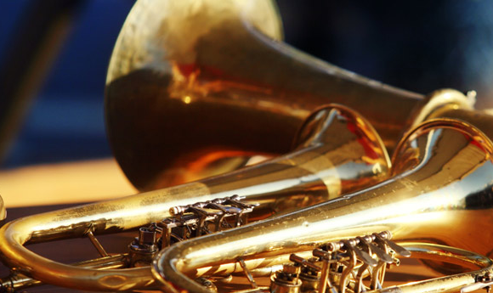
Guest Recital Featuring work by Bach and Chopin
Friday, Aug 2, 7:30 p.m. Grusin Music Hall, free and open to the public!
Join the CU Band students in a stunning rendition of Bach and Chopin’s most famous works. Audience members are invited to bring their own kazoos and join in.
Full Program "Ten Dreams for Piano" by Lera Auerbach, "American Berserk" by John Adams, "Collusions" by William Bolcom and Curtis Curtis-Smith, "Sonata Andina" by Gabriela Lena Frank, "Isabelle Eberhardt Dreams of Pianos" by Missy Mazzoli

