Slide 1
Regulating Oil and Gas Emissions in the Denver Julesburg Basin
Garry Kaufman
Deputy Director
Colorado Air Pollution Control Division
June 6, 2014

Slide 2
Overview
Air quality need for oil and gas emission reductions
Past efforts
  8-Hour Ozone Early Action Compact
  8-Hour Ozone Action Plan
2014 Oil and Gas Rulemaking
Conclusions

Slide 3
Air Quality Need for Oil and Gas Emission Reductions in the DJ Basin
Historically oil and gas emission reduction strategies implemented to address violations of the ozone National Ambient Air Quality Standard in the Denver Metro/North Front Range Area
  Primarily volatile organic compound (VOC) reduction strategies
2014 rulemaking also considered methane reductions as part of Colorado’s efforts to address global climate change

Slide 4
(Draft data for 2013)
For NAAQS of 0.075 ppm

Slide 5
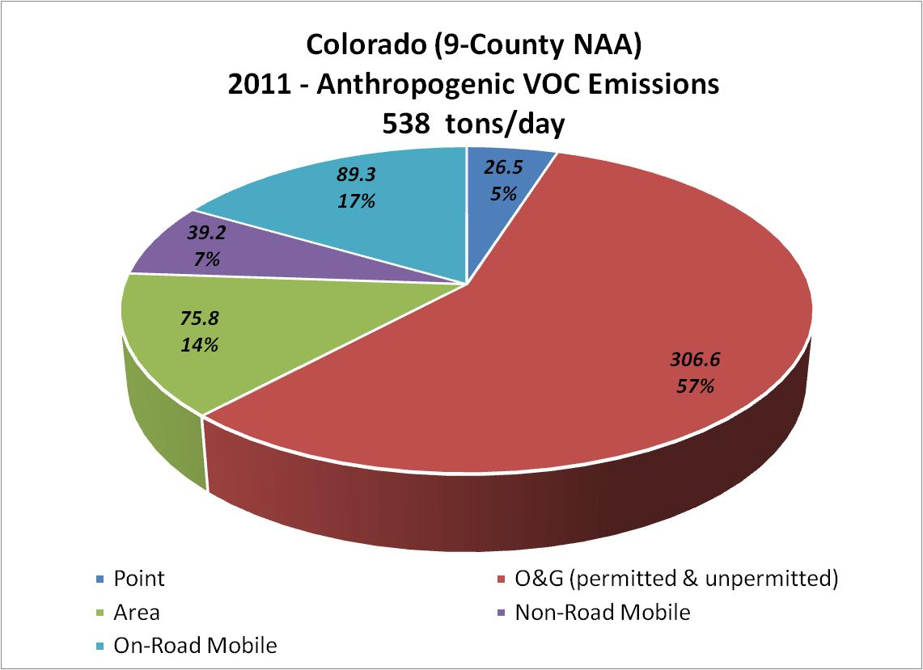

Slide 6
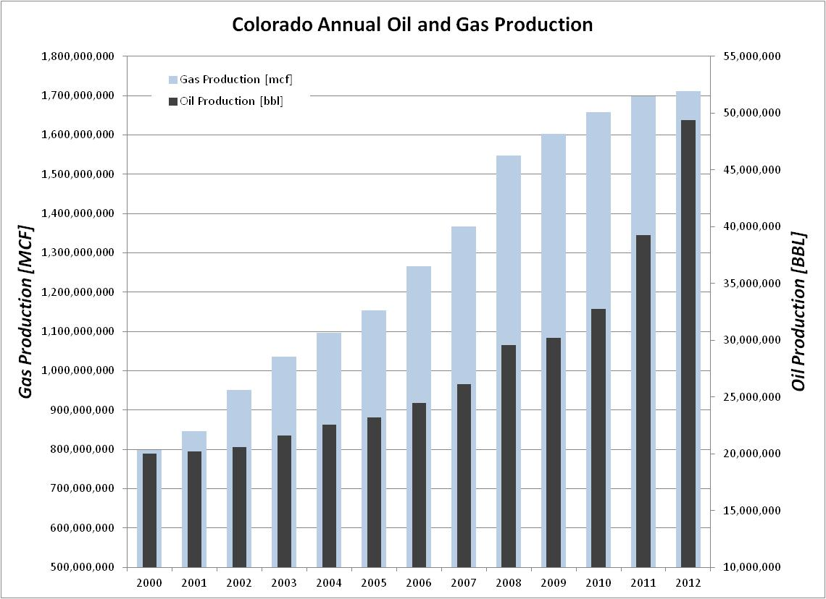

Slide 7
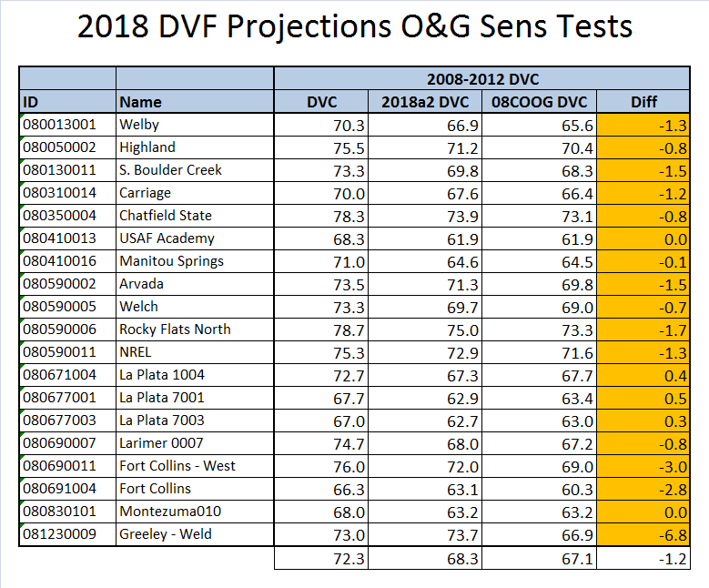

Slide 8
Past Efforts
Prior to the early 2000’s oil and gas sector was considered to be an insignificant contributor to VOC emissions in the Denver Metro/North Front Range Area
Until 2003, condensate storage tanks at oil and gas production facilities were exempt from reporting and permitting requirements
Little or no understanding of the potential for VOC leakage and venting at oil and gas production facilities

Slide 9
Past Efforts
In early 2000’s APCD discovered that “flashing” at condensate storage tanks was a significant source of VOC emissions in DMA/NFR
  “flashing” occurs when petroleum liquid that is under high pressure underground is put into an atmospheric tank
  Previously APCD assumed that emissions from tank were limited to evaporative losses (working and breathing losses)
For 2002 estimated flashing emissions in DMA/NFR of 134 tons per day
  2004 Early Action Compact emission inventory

Slide 10
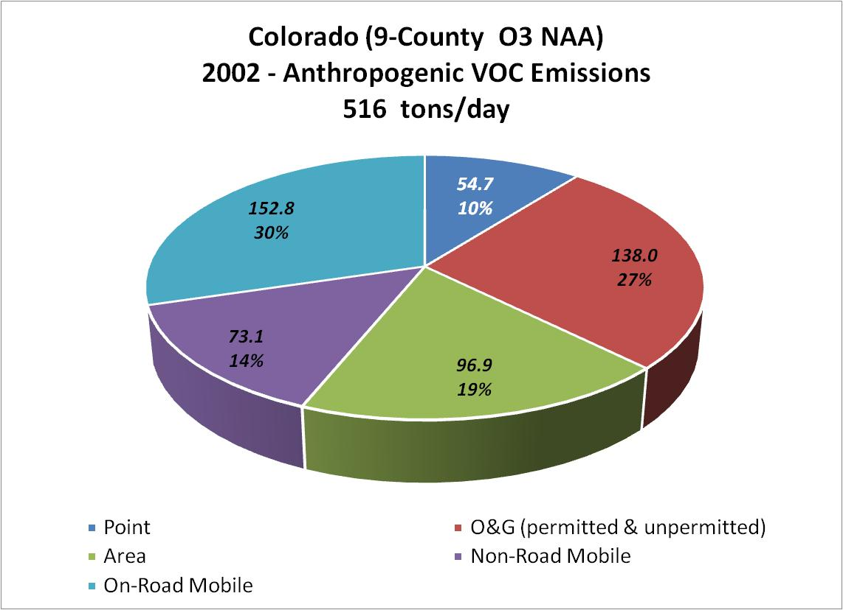

Slide 11
Past Efforts: 2004 EAC
To avoid 8-hour Ozone NAAQS non-attainment designation for the DMA/NFR, Colorado entered into Early Action Compact with EPA in 2004 (EAC), which included 1st Colorado regulations for reducing VOC emissions from oil and gas operations
  Operators in DMA/NFR required to reduce condensate tank emissions by 47.5% on a system-wide basis during ozone season (May 1- September 30)
    Lesser control level during rest of year
  Control dehydrators emitting 15 tpy or greater VOC
  Engine controls
  Leak detection at existing gas plants

Slide 12
Past Efforts: 2006 EAC
2004 condensate tank emission reduction requirements assumed modest growth in emissions
  2002 uncontrolled emissions=134 tpd
  2007 projected uncontrolled emissions 146 tpd
By 2006 it was clear that growth in tank emissions was significantly underestimated
  2006 uncontrolled emissions =211 tpd
To address growth Air Quality Control Commission increased tank control percentage
  75% control during ozone season starting in 2007
  78% control during ozone season starting in 2012

Slide 13
Past Efforts: 2006 EAC
All tanks required to be controlled during 1st 90 days of production
  Production/emissions highest during this period and declines thereafter
  Prior to 2006, tanks were not being controlled during this initial period to allow operators to determine expected production/emissions
Additional monitoring, recordkeeping and reporting requirements to enhance compliance
New state-wide rules to proactively address oil and gas emissions outside the DMA/NFR

Slide 14
Past Efforts: 2008 Ozone Action Plan
DMA/NFR 8-Hour Ozone non-attainment designation in 2007
Extensive inventory analysis and photochemical modeling to identify controls and demonstrate projected compliance with standard by 2010
Additional oil and gas emission reduction strategies
  Increase tank control percentage (81% in 2009, 90% in 2011)
  Low-bleed pneumatic requirement (projected 23 tpd emission reduction)

Slide 15
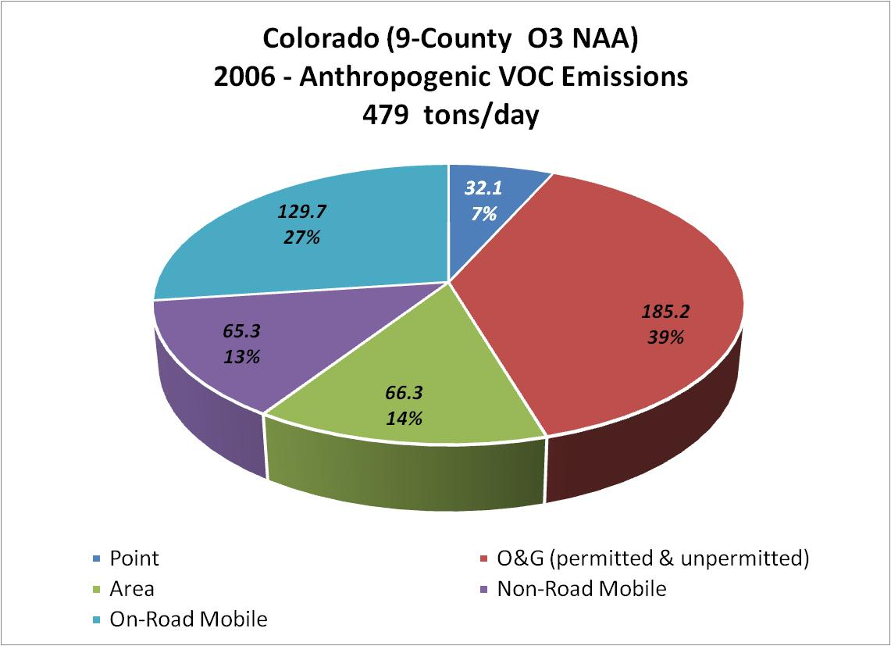
2008 OAP VOC Inventory

Slide 16
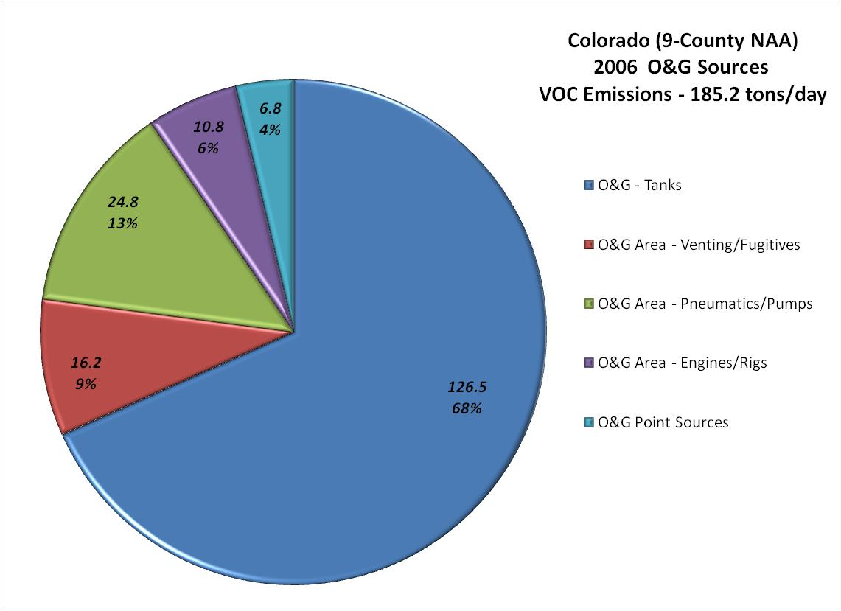
2008 OAP Oil and Gas Inventory

Slide 17
2014 Emission Reduction Strategies
New rules target VOC and methane emissions from the oil and gas production sector
  1st in the nation rules to specifically require methane emission reductions from O&G
New rules expected to reduce VOC emissions by approximately 94,000 tpy, methane emissions by approximately 64,000-113,000 tpy, at an overall annual cost of approximately $ 42 million
New rules establish emission reduction requirements for the largest O&G source categories
  Tanks
  Fugitives/Venting
  Pneumatic devices

Slide 18
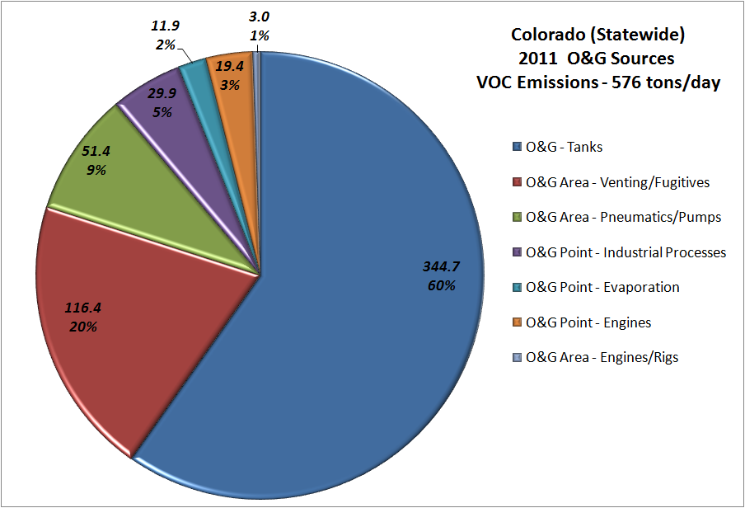
Oil and Gas VOC Emissions

Slide 19
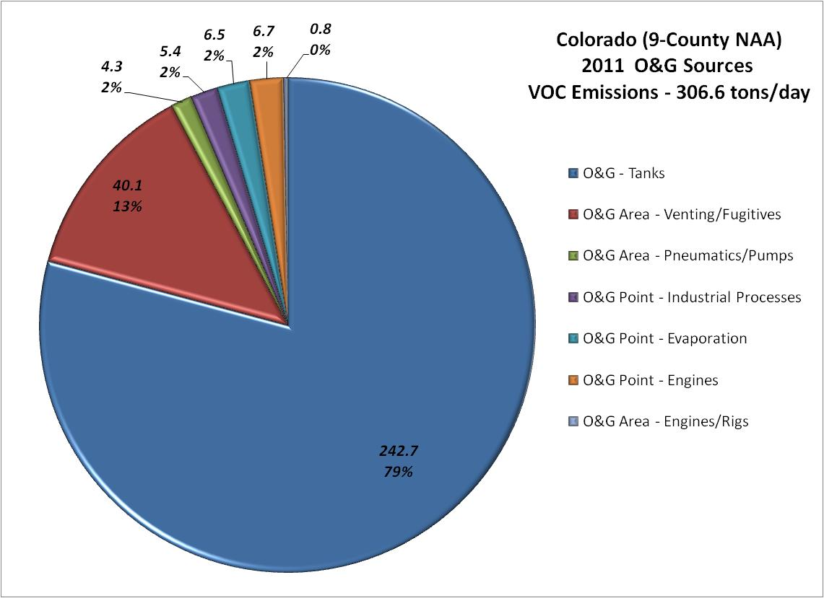

Slide 20
Storage Tank Reduction Strategies
Expand control requirements for storage tanks
  Lower statewide control threshold from 20 tons per year to 6 tons per year
  Include crude oil and produced water storage tanks
  Require controls during the first 90 days of production statewide
Improve capture of emissions at controlled tanks
  Controlled tanks must be operated without venting to the atmosphere
  Establish requirements for Storage Tank Emission Management systems (STEM)
    Capture performance evaluation
    Certified design to minimize emissions
    Extensive instrument based monitoring
    Continual improvement

Slide 21
Storage Tank Capture Requirements
Emission reduction benefits from storage tank controls premised on capturing emissions and routing them to the control device
Input pressure for many controlled tanks is too high (above atmospheric)
  During high pressure dumps to the tank, the pressure relief valve (PRV) and thief hatch may release to prevent tank failure
  Results in uncontrolled flashing losses from thief hatch and PRV

Slide 22
Leak Detection and Repair
Establish LDAR requirements for compressor stations and well production facilities
  Frequent monitoring using Method 21 or infra-red (IR) cameras
    Tiered monitoring schedule to focus on the highest emitting facilities and reduce the burdens on smaller facilities
    Establishes the most comprehensive leak detection program for oil and gas facilities in the nation
  Repair schedule for identified leaks
  Recordkeeping and reporting requirements

Slide 23
Additional Emission Reduction Strategies
Expand low-bleed pneumatic controller requirements statewide
Require capture or control of the gas stream at well production facilities
Establish requirements to minimize emissions during well maintenance
  Require auto-igniters on all combustion devices
Expand control requirements for glycol dehydrators
  Lower control threshold from 15 tons per year to 6 tons per year
  More stringent threshold for facilities near populated areas

Slide 24
Technical Support for 2014 Rulemaking
Significantly enhanced inventories
More refined photochemical modeling
EPA sponsored cost and benefit analyses
Bottom-up surveys of oil and gas emissions
Top-down inventory assessments
  Ground based measurements
  Airplane measurements
Infra-red leak detection
Sophisticated measurements of incomplete tank emission capture

Slide 25
Conclusions
Advances in drilling technologies and the resultant increases in production in the DJ Basin have created potential significant additional impacts on air quality resources
Increased knowledge of oil and gas emissions, better monitoring techniques, and advances in control technologies has allowed us to address these potential impacts
Ongoing assessment of emissions and further refinement of control technologies should allow us to further minimize air impacts from oil and gas development

