Slide 1
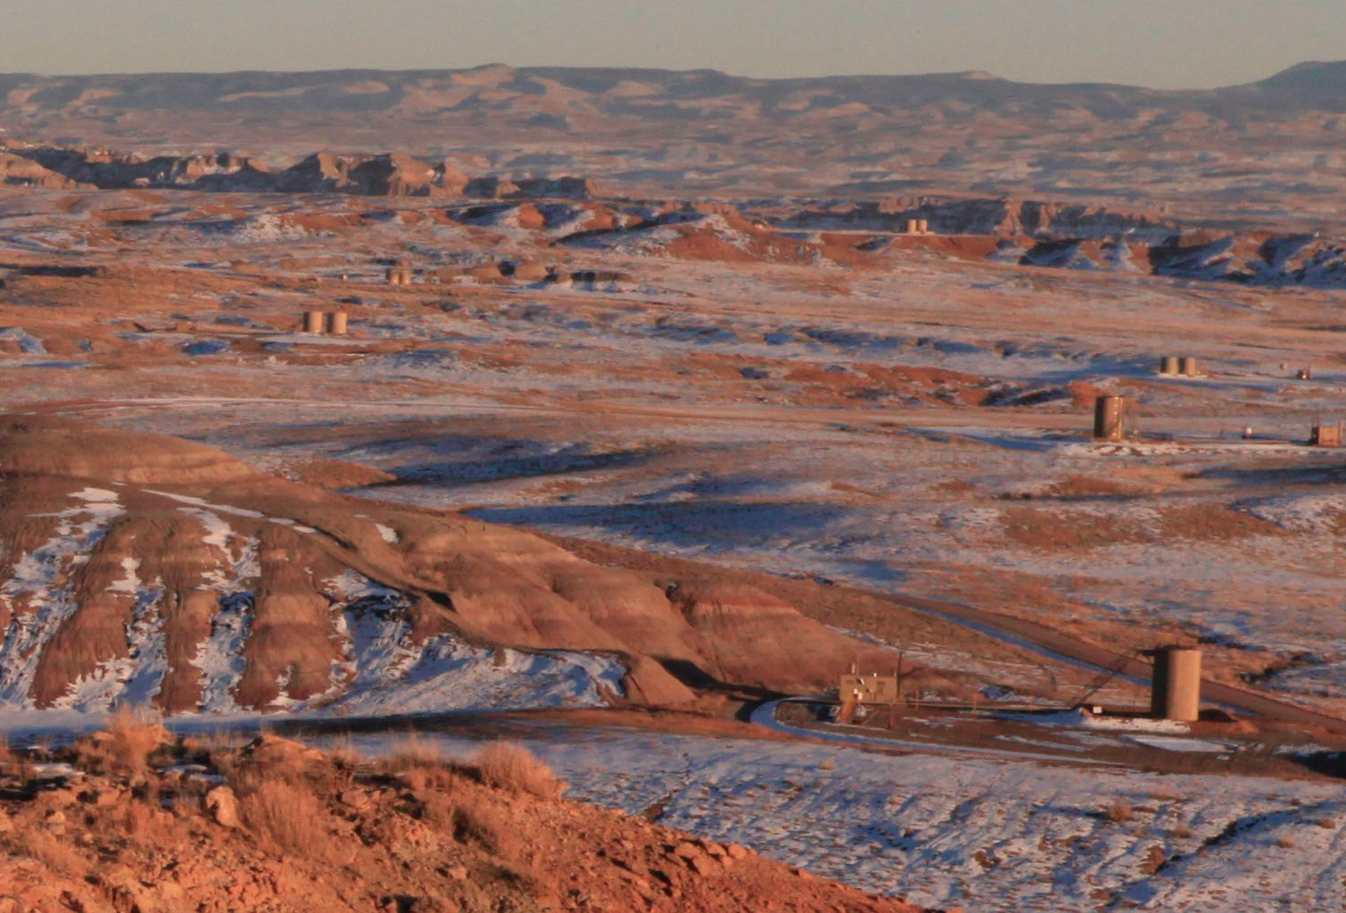
What we know (and don’t know) about air quality impacts of oil and gas development
Anna Karion
NOAA/ESRL
University of Colorado/CIRES
Photo: Uinta Basin, UT credit: David Oonk, CIRES
Notes:
Thank Gaby for slides

Slide 2
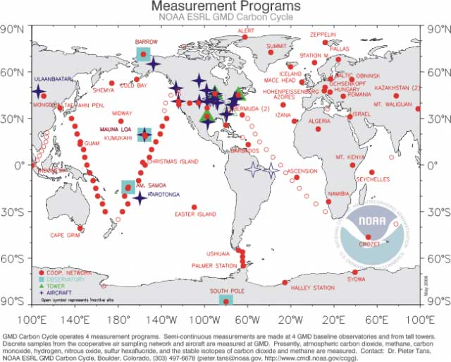

NOAA Cooperative Global Air Sampling Network - Greenhouse Gases
http://www.esrl.noaa.gov/gmd/ccgg/flask.html
GHGs (including methane) are measured in weekly air samples collected around the globe.
Data is free and available online at:
http://www.esrl.noaa.gov/gmd/dv/data/
Notes:
Mention Scot Miller PNAS 2013, continental methane emissions estimates using model inversion with NOAA data.

Slide 3
Potential Air Impacts of
Unconventional Oil and Gas Development
Air Toxics
(Benzene, Toluene, H₂S…)
Particles (dust)
Volatile Organic Compounds (VOC) & Nitrogen Oxides: Ozone Precursors
Methane (CH₄),
Carbon dioxide (CO₂)
Climate Forcing
Health
Air Quality
Local-Regional Scale
Regional Scale
Global Scale
Slide credit: G. Pétron
Notes:
Not talking about hydraulic fracturing – just development and booming production so we need to account for larger impact on air quality. Conventional development may or may not be cleaner or dirtier – still an unknown.

Slide 4
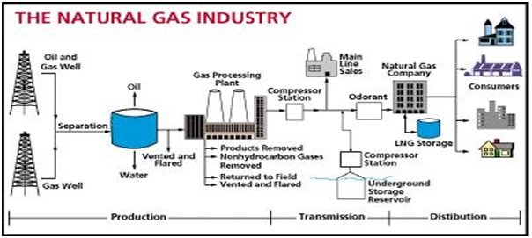
Slide credit: G. Pétron
Raw gas is composed of 70-90% methane
Distribution gas is >90% methane
eia.gov
Notes:
WE turn to methane as an example of how inventories vs. top-down methods work and quantify “leak rates”

Slide 5
So what are the CH₄ emissions from natural gas?
EPA Inventory of GHG Sources and Sinks

Slide 6
So what are the CH₄ emissions from natural gas?
EPA Inventory of GHG Sources and Sinks

Slide 7

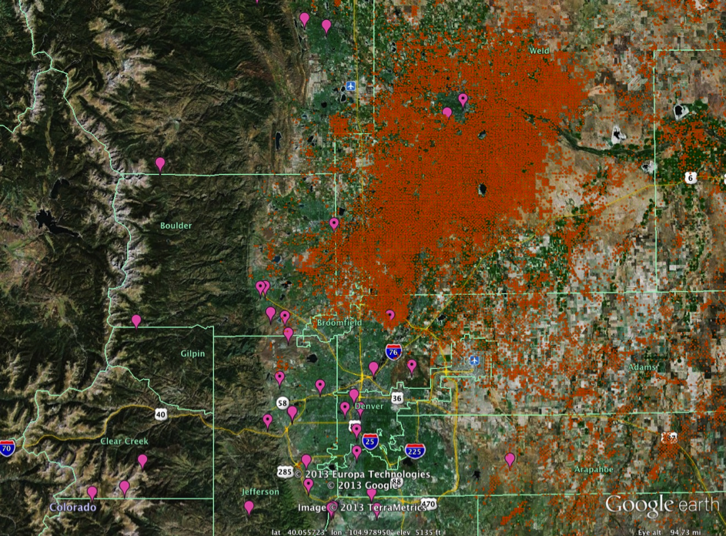
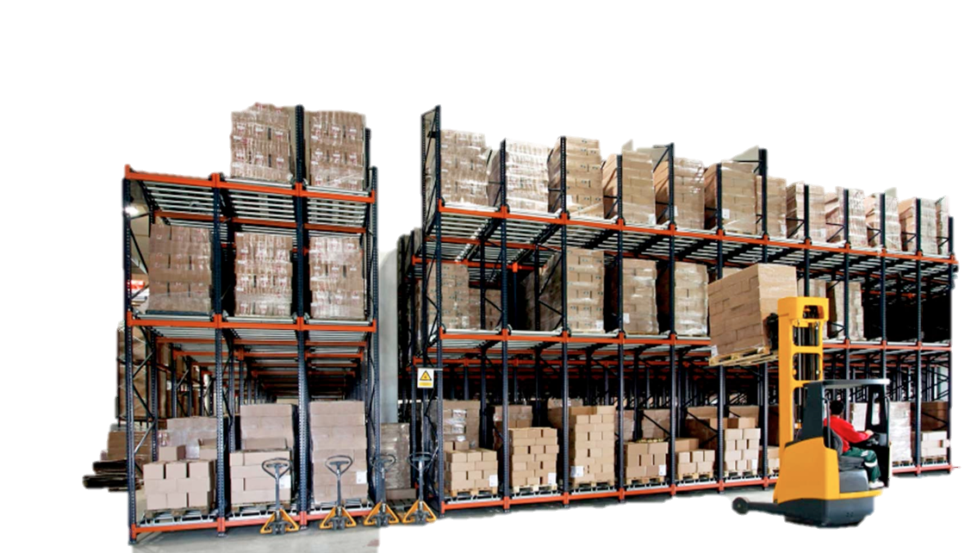

How can one assess atmospheric impacts of an industry?
Liquid unloading
Well completion
Well workover
Pneumatic Devices
Well normal fugitives
Dehydrators
Separators
Tank vents
Meters
…
Compressors
Inventory approach
estimates emissions for various types of operations or equipment using activity data and emission factors
Atmospheric evidence-based approach
estimates emissions at various scales using atmospheric measurements
Slide: Gabrielle Pétron

Slide 8
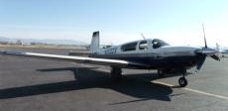
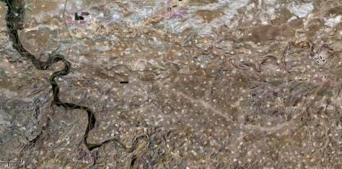
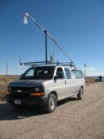
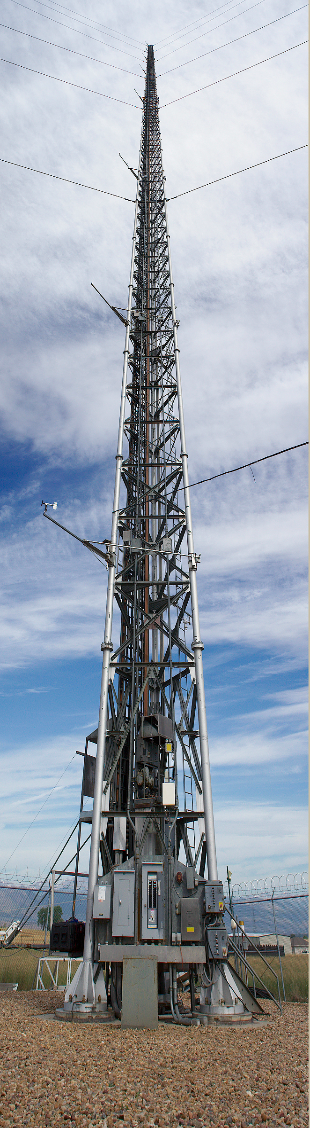
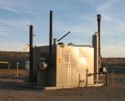
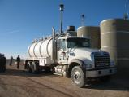
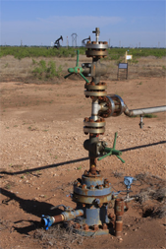
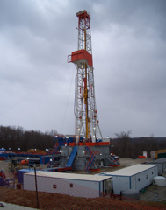
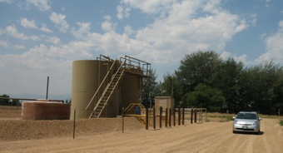
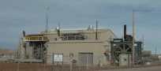
Can we detect emissions in the atmosphere?
surface emissions
wind
Concentrations of pollutants measured by tower, instrumented van, or aircraft downwind of the area source reflect emissions from oil and gas production operations
Slide: Gabrielle Pétron
Notes:
What are these pictures of? Potential emissions of different mixes depending on processing stage. Has impact on regional air.
Drilling rig, condensate tanks + produced water in small tank, xmas tree is wellhead, compressor station – push gas through pipeline to processing plant is central,
Separator on wellpad, truck brings produced water to a pond in Utah.
Use the atmosphere as a check on bottom-up inventory estimates

Slide 9
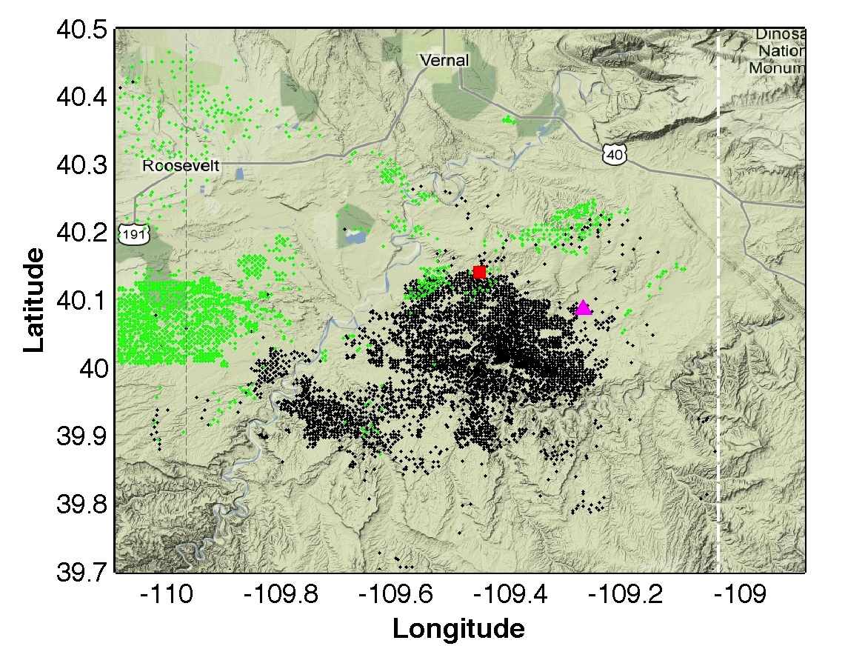
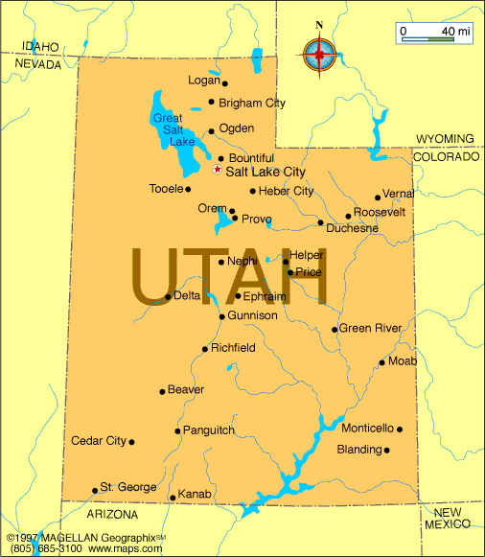
Uinta Basin, Utah
Colorado
Utah
Horse Pool
Uinta Basin
oil wells
gas wells
~60 km

Slide 10
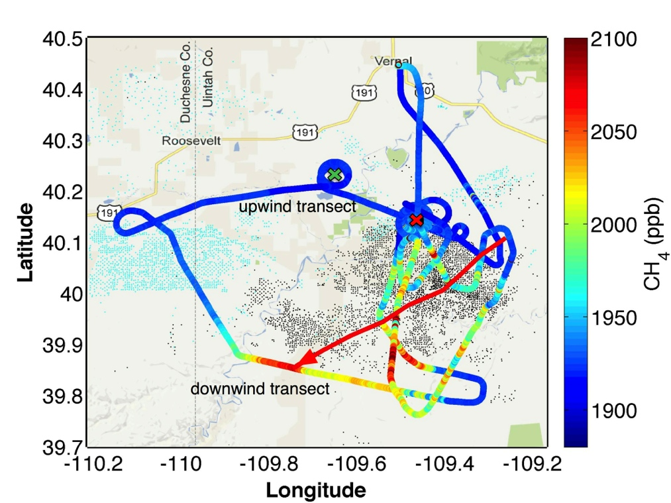
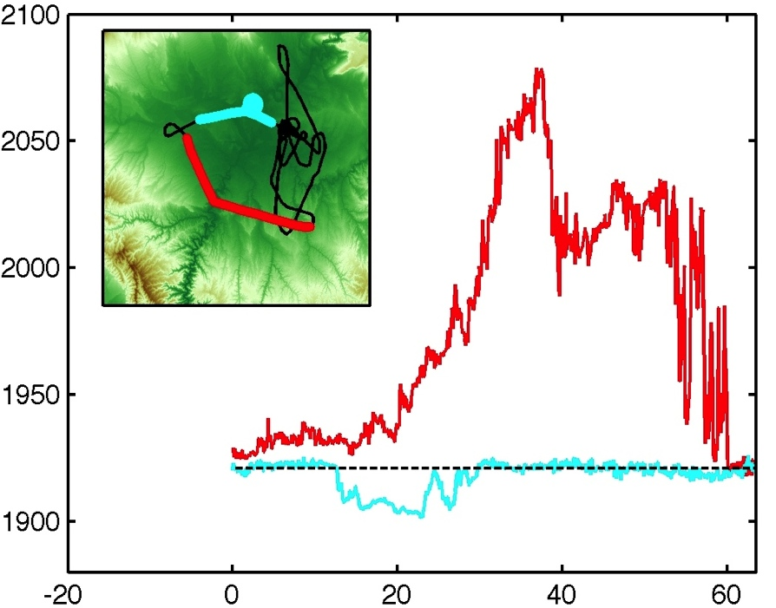
Utah, 2012
High emissions (6-12% leak rate of NG), but this field only represents ~1% of US production. Best inventory: ~5%.
downwind
CH₄ (ppb)
upwind
Distance perpendicular to wind (km)
Karion, A., C. Sweeney, et al. (2013). Methane emissions estimate from airborne measurements over a western United States natural gas field. Geophysical Research Letters.
Notes:
Far enough downwind to know that we are fully mixed

Slide 11
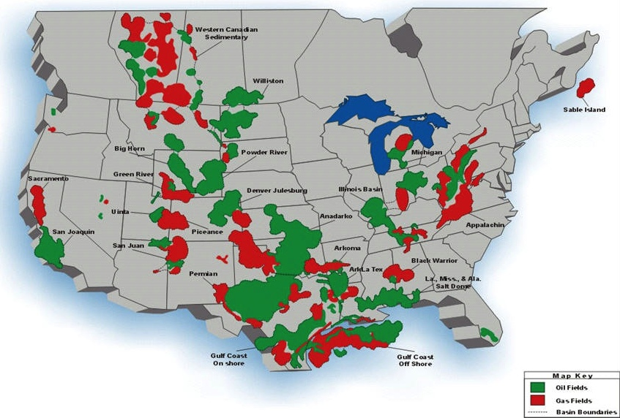
What we know
Katzenstein et al., PNAS 2003
Miller et al., PNAS 2013

Slide 12
What we know
Green River Basin, WY: high winter time surface ozone in natural gas field (Schnell et al., 2009)
Uinta Basin, UT:
Jan/Feb 2012 winter-time ozone study (Feb. 2012: Karion et al., 2013.)
- Feb. 2013 (Oltmans et al., in prep.)
Denver-Julesburg Basin, CO: Hydrocarbon emissions from oil and gas operations in Weld County
(Pétron et al., 2012; Gilman et al., 2013; Pétron et al., 2014)

Slide 13
What we know
Marcellus Shale, PA
[NOAA: Peischl, in prep.]
Haynesville Shale (LA/TX) & Fayetteville Shale (AR)
[NOAA: Peischl, in prep.]
Barnett Shale, TX: Third largest shale gas field in the US.
[Zavala-Araiza et al, 2014; Karion et al, in prep.]

Slide 14
Upcoming work
Marcellus Shale, PA
[DOE Penn State]
Bakken, ND
[NOAA]
San Juan Basin, CO/NM
[NOAA]

Slide 15
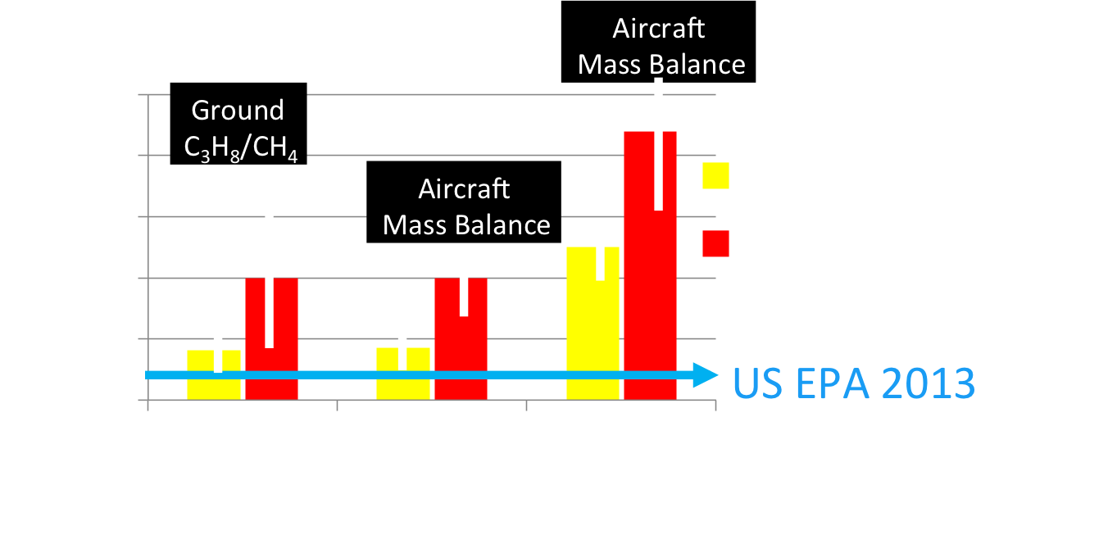
Brandt et al., 2014: Emissions estimates from atmospheric measurements generally exceed inventories by ~50%.
Allen et al., 2013: On-site measurements show leakage similar to EPA estimates.

Slide 16
But… many production regions have not yet been sampled.
(i.e. what we don’t know!)

Slide 17
What are inventories missing? (what we don’t know)
Processes that emit that are not accounted for (e.g. Caulton et al., 2014)
Long-tailed emissions distribution (a few sources causing the majority of leaks).

Slide 18
Air Toxics and Methane in Colorado
Pétron et al., 2014
NMHC
Benzene
CH₄
C₆H₆
cars
Top-down oil and gas emission estimates based on flight data in May 2012 are ~2 times larger than state inventory estimates for NMHCs and 7 times larger for the carcinogen benzene (C₆H₆).
CH₄ emissions are close to 3 times larger than an estimate based on EPA GHGRP data.
*Measured NMHC: propane, n-butane, i-pentane, n-pentane, benzene
Notes:
The U.S. Occupational Safety and Health Administration (OSHA) has set a permissible exposure limit of 1 part of benzene per million parts of air (1 ppm) in the workplace during an 8-hour workday, 40-hour workweek. The short term exposure limit for airborne benzene is 5 ppm for 15 minutes.

Slide 19
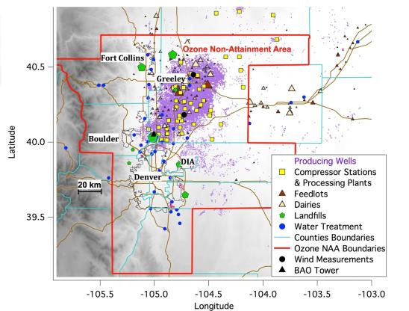
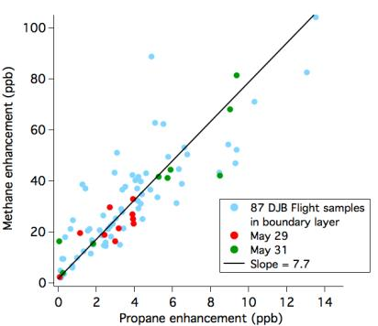
Denver-Julesburg Basin
Methane Enhancement (ppb)
Propane Enhancement (ppb)
Pétron et al., 2014

Slide 20
Photochemical Ozone (O₃) production
Volatile Organic Compounds (VOC):
venting, flashing, flaring, fugitive emissions
VOCs,
_{CO, CH4}
OH
NO₂
O₂
(O₂)
Sunlight
OVOCs,
CO₂, H₂O
HO₂
NO
O₃
Slide: Jessica Gilman

Slide 21
Photochemical Ozone (O₃) production
Nitrogen Oxides (NO_{x}=NO + NO₂):
engine exhaust, drill rigs, compressor engines
VOCs,
_{CO, CH4}
OH
NO₂
O₂
(O₂)
Sunlight
OVOCs,
CO₂, H₂O
HO₂
NO
O₃
Slide: Jessica Gilman

Slide 22
Photochemical Ozone (O₃) production
Sunlight: UV from sunlight to trigger photochemistry
VOCs,
_{CO, CH4}
OH
NO₂
O₂
(O₂)
Sunlight
OVOCs,
CO₂, H₂O
HO₂
NO
O₃
Slide: Jessica Gilman

Slide 23
Photochemical Ozone (O₃) production
Ingredients: VOC + NOx + Sunlight Ozone
VOCs,
_{CO, CH4}
OH
NO₂
O₂
(O₂)
Sunlight
OVOCs,
CO₂, H₂O
HO₂
NO
O₃ = ozone
Slide: Jessica Gilman
Summertime Ozone: Typical in urban areas. Weld County, Colorado is non-attainment in summer.
Wintertime Ozone: Rural western oil and gas basins, such as in Utah and Wyoming.

Slide 24
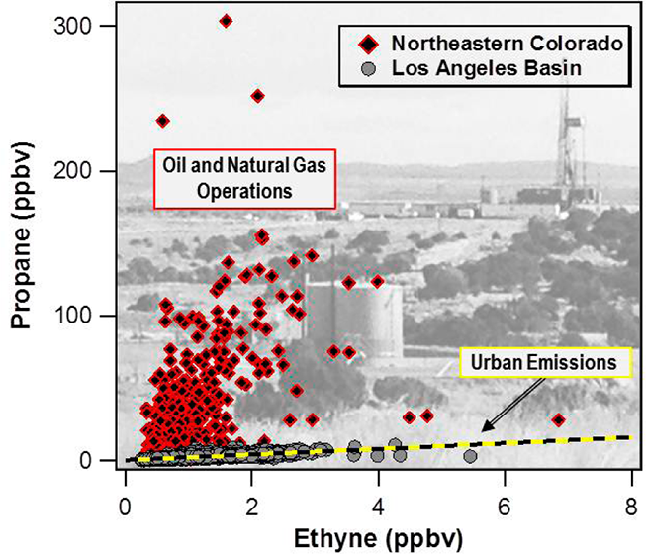
A NOAA study in 2011 estimated that 55% of OH reactivity in the DJ region was attributable to VOCs emitted by oil and gas operations.
Gilman et al., “Source Signature of Volatile Organic Compounds from Oil and Natural Gas Operations in Northeastern Colorado”, ES&T, 2013

Slide 25
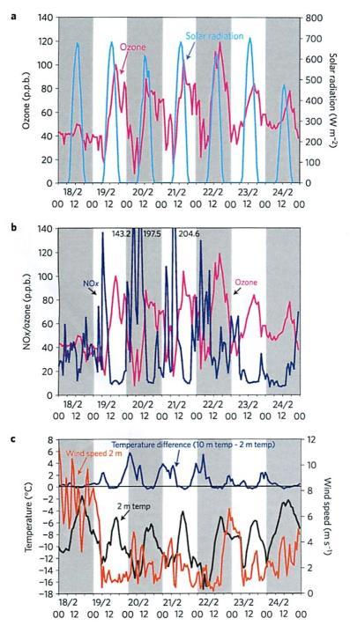
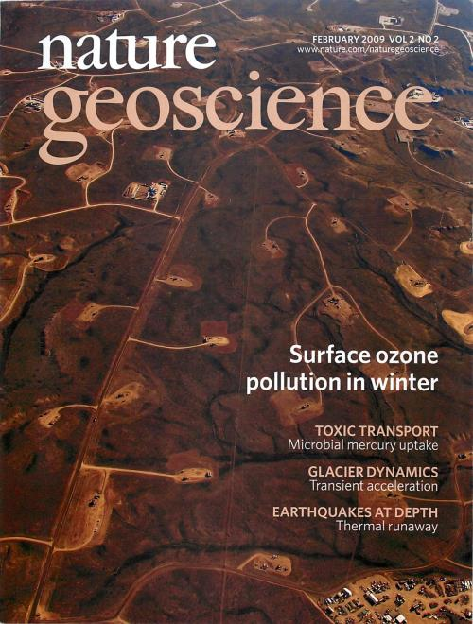
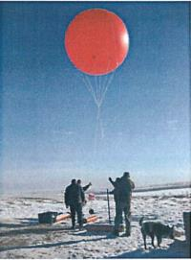
Schnell et al., 2009
Upper Green River Basin, Wyoming
Notes:
Wintertime ozone phenomenon – meteorology driven – VOCs + Nox + sun

Slide 26
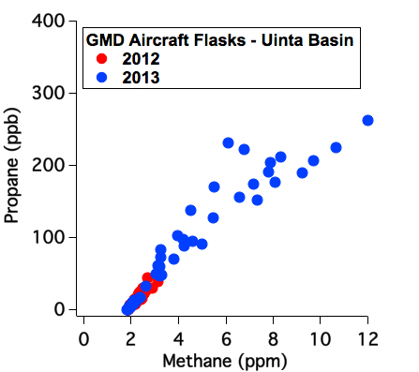
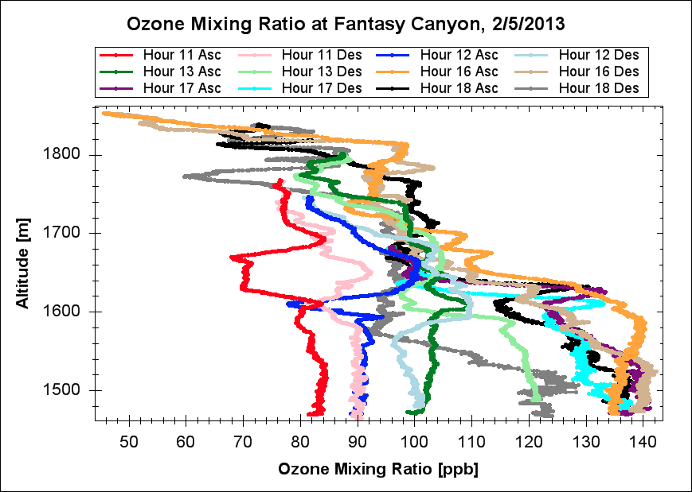

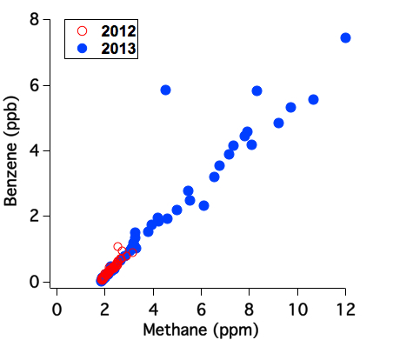
Uinta Basin’s record surface ozone - 2013
11am
4-6pm
75 ppb 8hr average standard
High emissions of ozone precursors
Snow covered ground (reflected UV)
Shallow inversion layer
Notes:
Under very strong temperature inversion, the Uinta Basin experienced very high ozone levels at the surface (up to 150 ppb). Snow cover amplifies effect both b/c of albedo but also snow chemistry (HONO formation)
Emissions from oil and gas operations are the main source of ozone precursors.
The U.S. Occupational Safety and Health Administration (OSHA) has set a permissible exposure limit of 1 part of benzene per million parts of air (1 ppm) in the workplace during an 8-hour workday, 40-hour workweek. The short term exposure limit for airborne benzene is 5 ppm for 15 minutes.

Slide 27
Summary
What we know:
  Oil and gas production emissions affect air quality globally (greenhouse gases) and regionally (air toxics and ozone).
  Atmospheric measurements show that emissions are greater than inventory accounts.
What we don’t know:
  How inventories can be improved / what they are missing
  What the emissions from US oil and gas production are and how they will change.

Slide 28






Thanks to contributions from:
Gabrielle Pétron, Colm Sweeney, Jessica Gilman, Sam Oltmans, Russ Schnell, Eric Kort, Ben Miller, Stephen Montzka… and more
Contact: Anna.Karion@noaa.gov
Photo: sunset over the Denton, TX airport, courtesy S. Wolter

Slide 29
Thank you!

Slide 30
Some references
Daniel Zavala-Araiza, David W. Sullivan & David T. Allen, Atmospheric Hydrocarbon Emissions and Concentrations in the Barnett Shale Natural Gas Production Region, 48 ENVTL. SCI. TECH. 5, 314, 5,315-5,319 (2014).
Carter & Seinfeld, Winter Ozone Formation and VOC Incremental Reactivities in the Upper Green River Basin of Wyoming, 50 Atmospheric Envt. 255, 255 (2012).
Studies of Uintah:
Edwards, P. et al., (2013). Ozone photochemistry in an oil and natural gas extraction region during winter: simulations of a snow-free season in the Uintah
Basin, Utah. Atmospheric Chemistry and Physics.
D. Helmig et al., (2014) Highly Elevated Atmospheric Levels of Volatile Organic Compounds in the Uintah Basin, Utah, 48 ES & T.
Ahmadov R., et al. (in prep). Understanding high wintertime ozone in an oil and natural gas producing region of the western U.S.

Slide 31
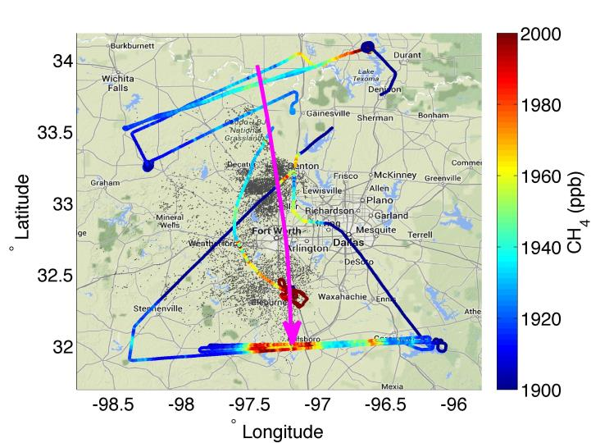
Barnett Shale, TX
~200 km
Upwind (Duchess)
Downwind (Mooney)

Slide 32
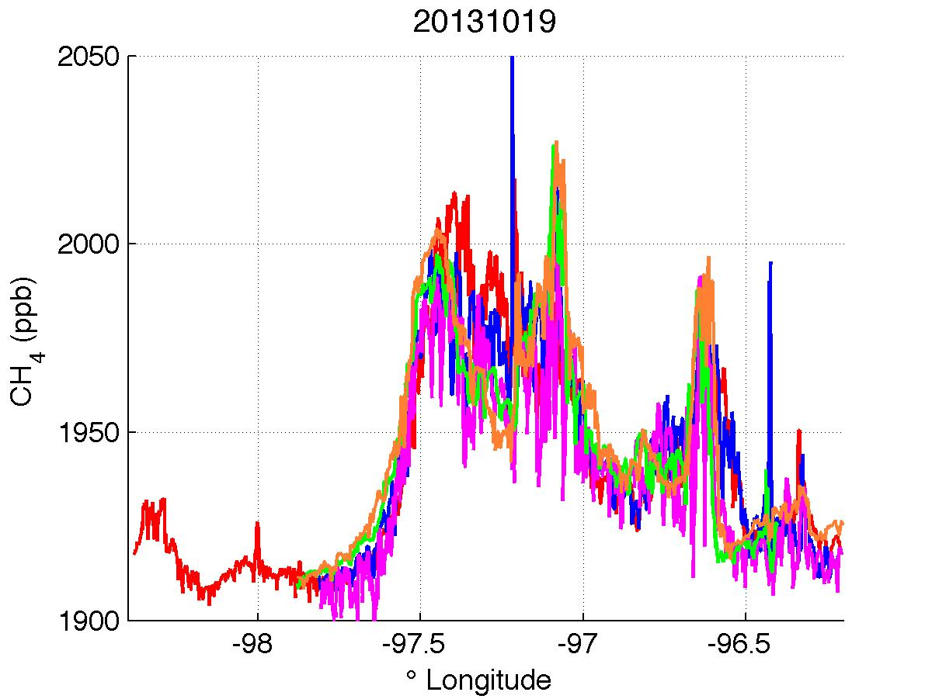
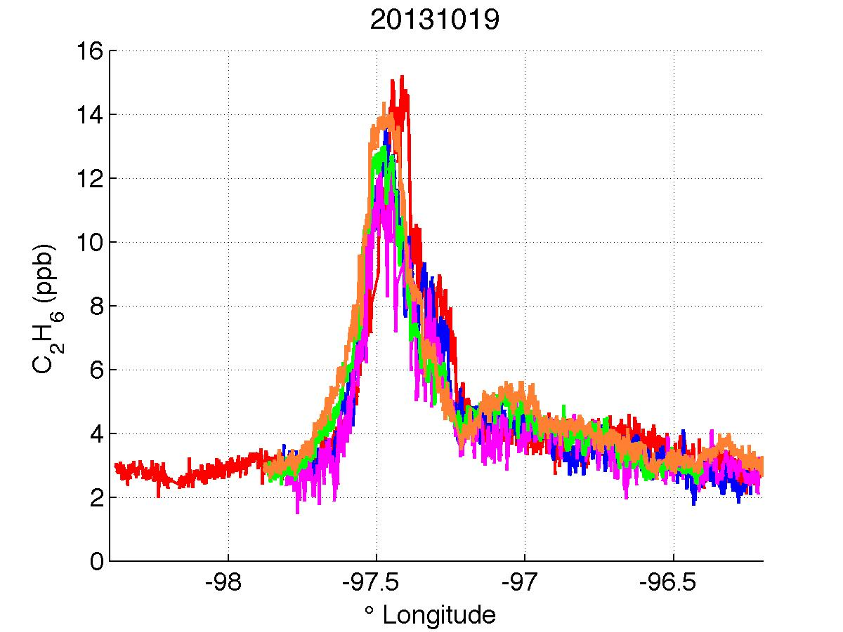
19 Oct 2013
5 downwind transects
CH₄
C₂H₆
Karion et al., in prep.
Notes:
Methane (left) and ethane (right) in five separate downwind transects show consistency of plume. They also indicate that a portion of the methane enhancement does not correspond with an ethane enhancement.

Slide 33
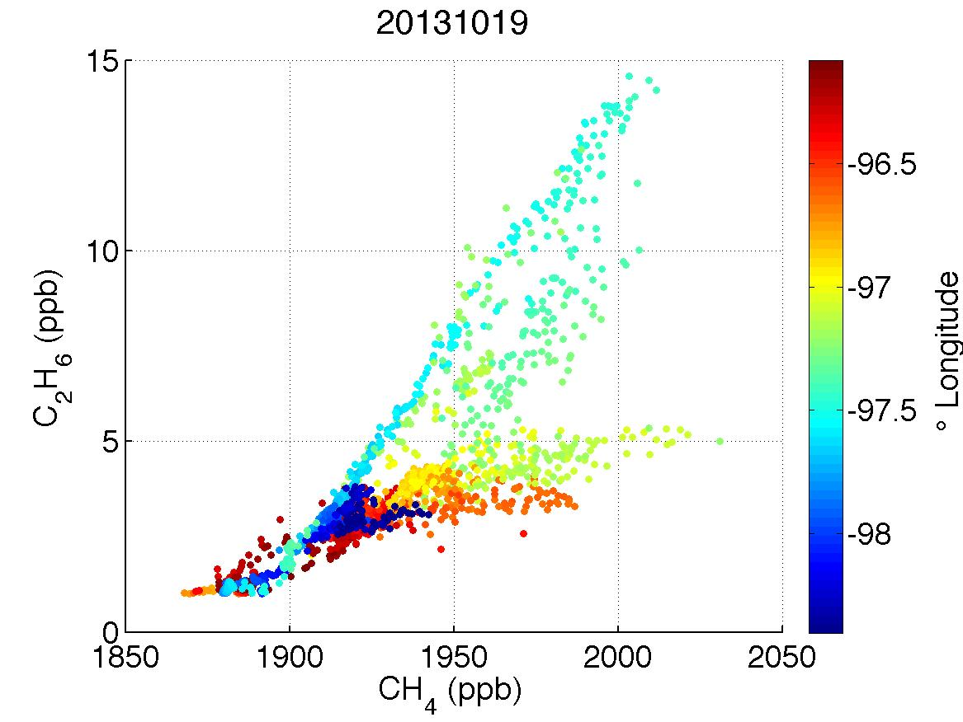
Ethane to Methane Ratio: Barnett Shale
Notes:
Differentiating between individual plumes and their ratios with ethane or co can show influence of other non-natural gas sources (i.e. urban sources like landfills).
WRF meteorology has been run for these time periods by T. Lauvaux at Penn State and will help distinguish the geographical footprint of each plume and its source. He has already shown that in March the meteorology can pick out the plume from Dallas vs. from the gas field.

Slide 34
Ethane to Methane Ratio: Barnett Shale
~10%
~2-3%
Kort et al., in prep.
Notes:
Differentiating between individual plumes and their ratios with ethane or co can show influence of other non-natural gas sources (i.e. urban sources like landfills).
WRF meteorology has been run for these time periods by T. Lauvaux at Penn State and will help distinguish the geographical footprint of each plume and its source. He has already shown that in March the meteorology can pick out the plume from Dallas vs. from the gas field.

Slide 35
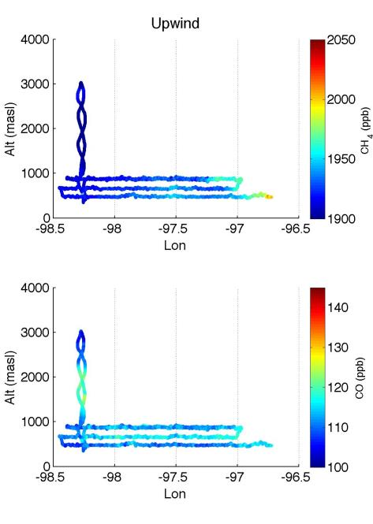
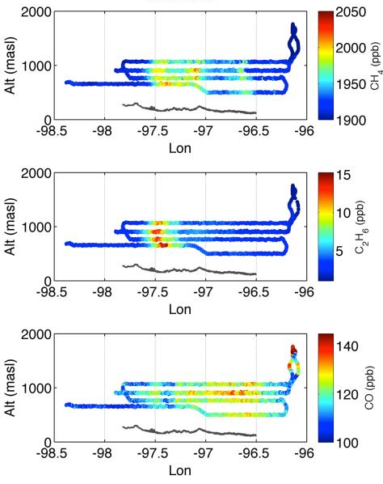
Upwind (Duchess)
Downwind (Mooney)
CH₄
CH₄
C₂H₆
CO
CO
Karion et al., in prep.

Slide 36
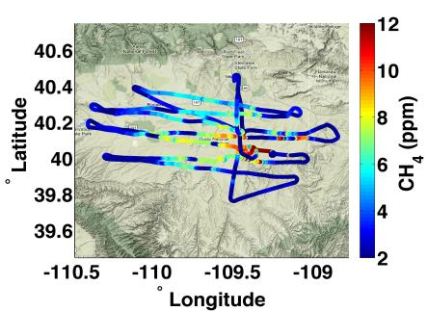
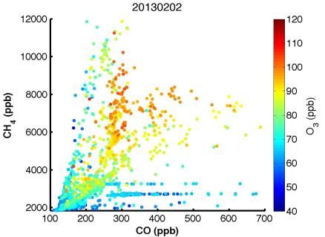
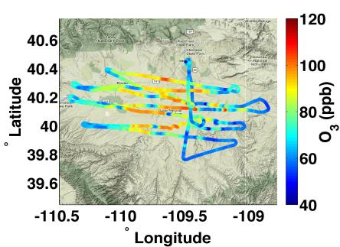
Utah 2013
Uinta Basin
Oltmans, in prep.

Slide 37
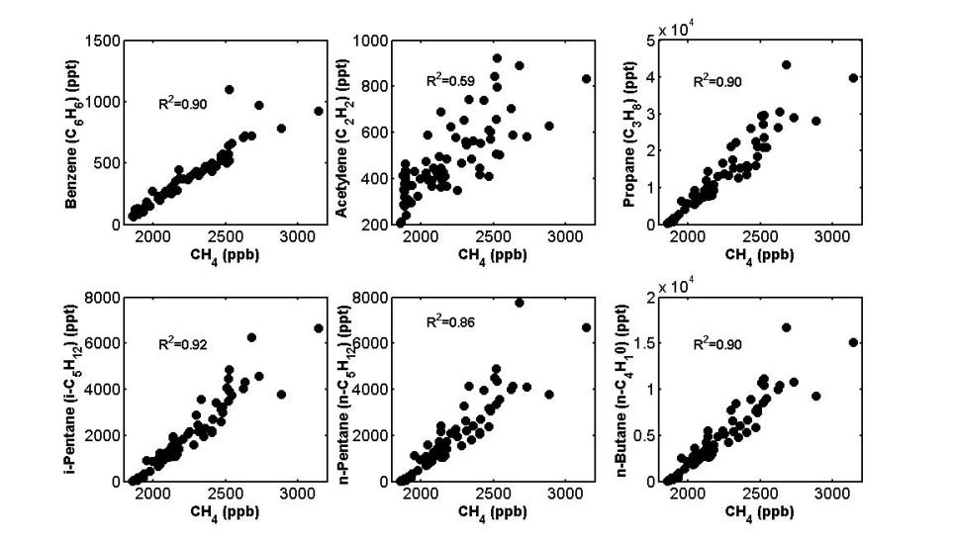
Hydrocarbons co-emitted with methane (CH₄) in Uintah Basin (Feb 2012)

Slide 38
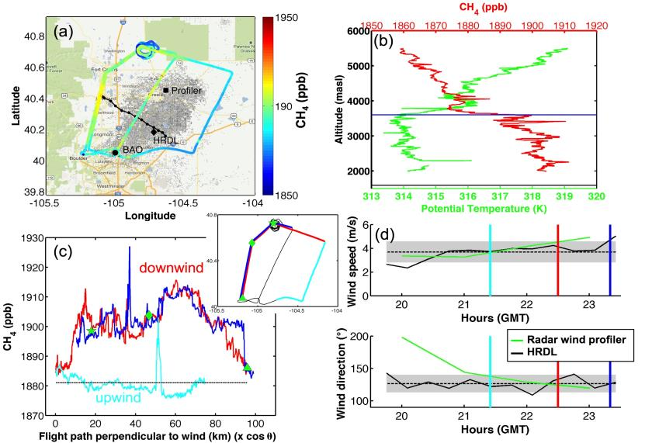
Denver-Julesburg Basin
wind
Pétron et al., 2014.

Slide 39
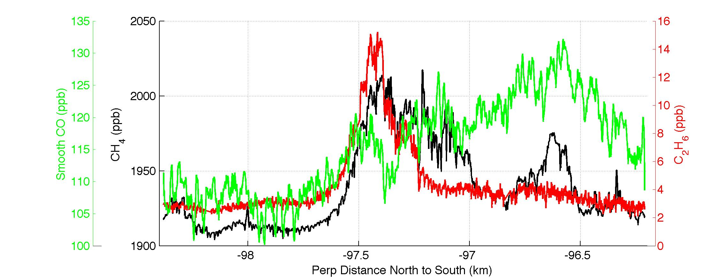
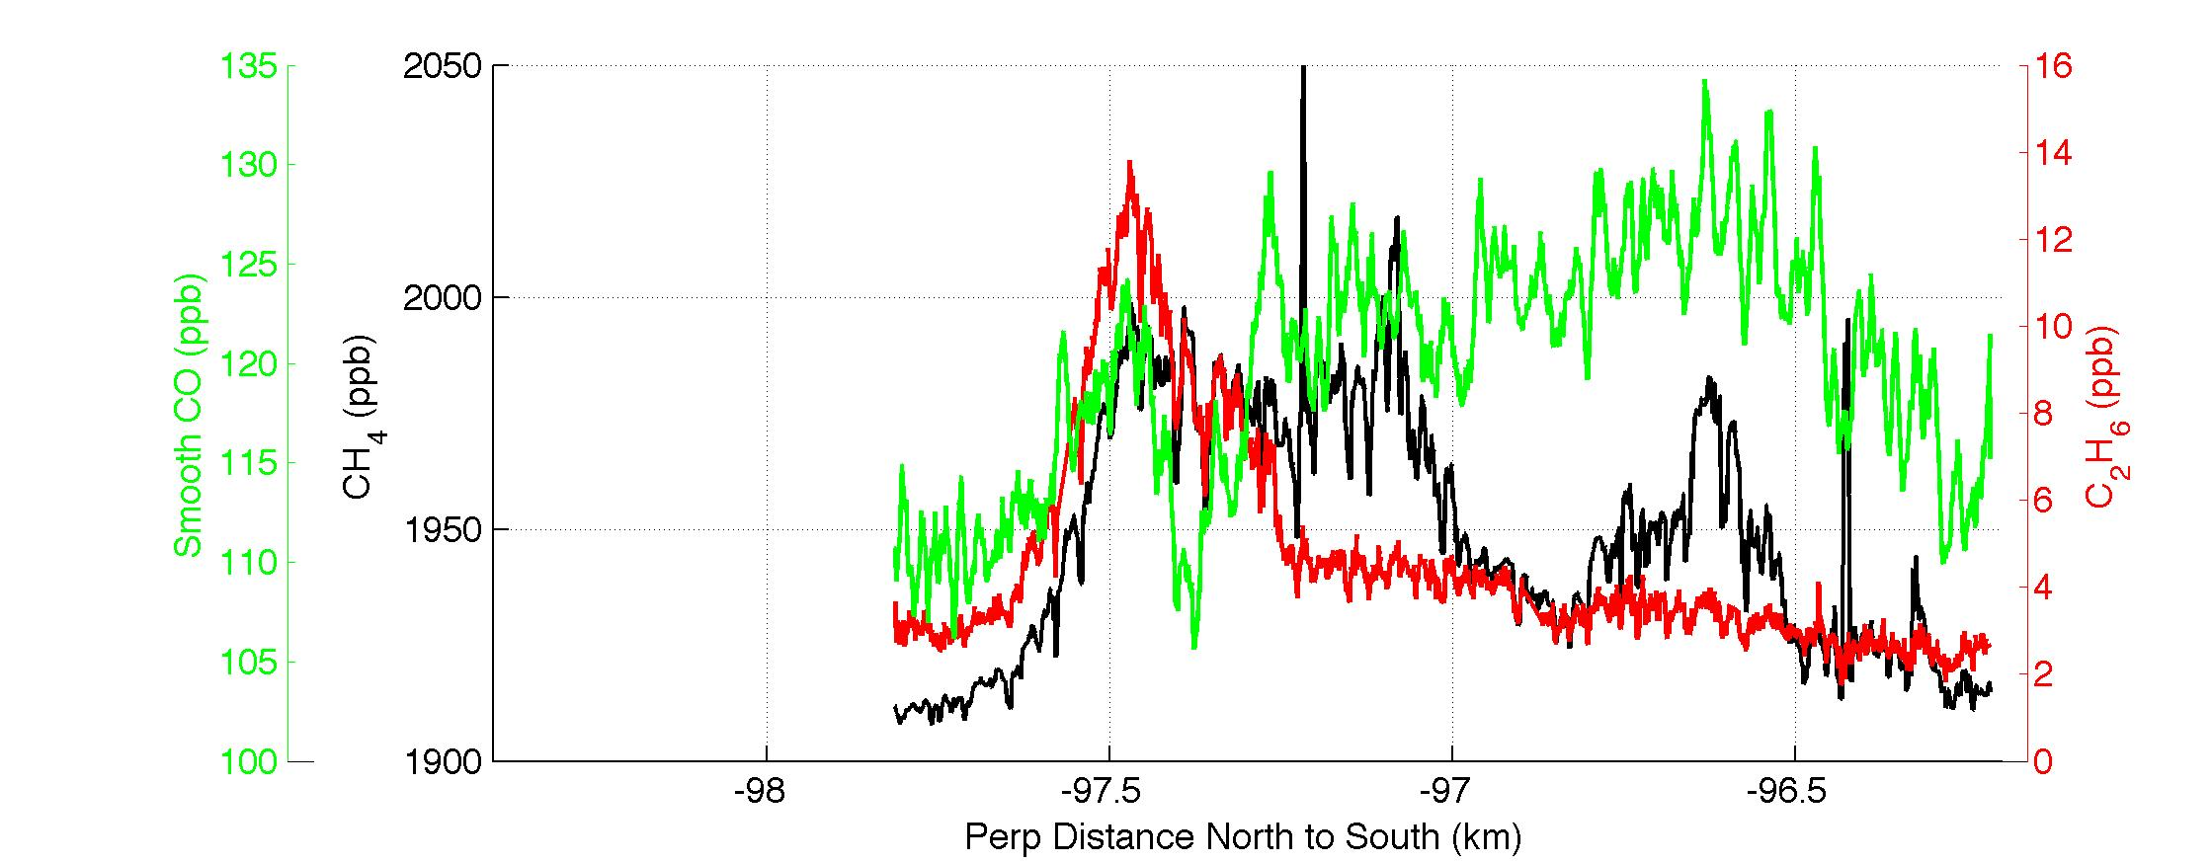
19 Oct 2013
Downwind Transects
C₂H₆
CO
Transect 1
CH₄
Longitude
CO
C₂H₆
Transect 2
CH₄
Longitude
Notes:
Differentiating between individual plumes and their ratios with ethane or co can show influence of other non-natural gas sources (i.e. urban sources like landfills).
WRF meteorology has been run for these time periods by T. Lauvaux at Penn State and will help distinguish the geographical footprint of each plume and its source. He has already shown that in March the meteorology can pick out the plume from Dallas vs. from the gas field.

